Slide 1
Syria From Struggle for Freedom to Humanitarian Crisis
Dr.Radwan Ziadeh
Director, Syrian Center for Political and Strategic Studies

Slide 2
Transitional Justice in the Arab World

Slide 3
Years of Fear in Syria

Slide 4
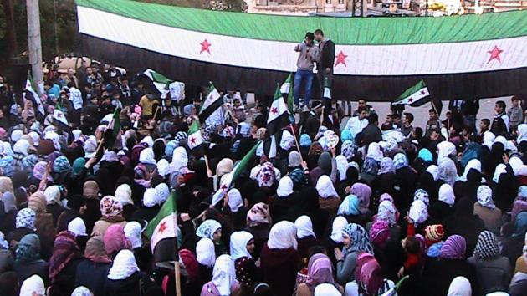
Syria`s Freedom

Slide 5
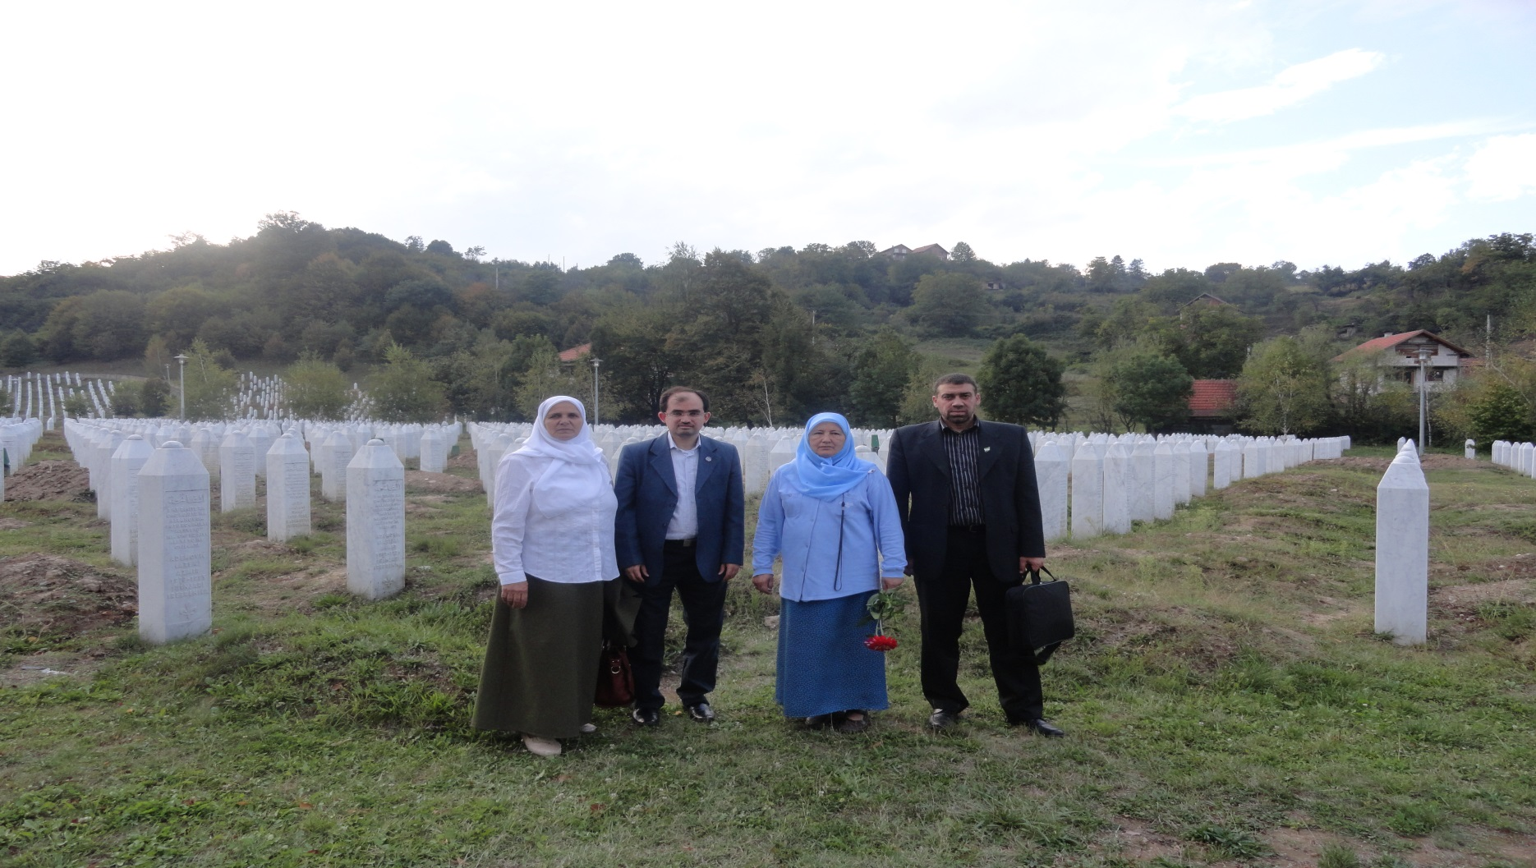
Bosnia

Slide 6
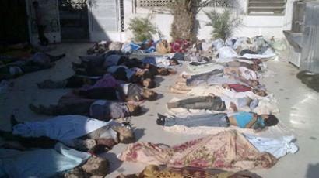
Syria Tragedy

Slide 7
Mohamad Al-abbar

Slide 8
Al-Abbar Family

Slide 9
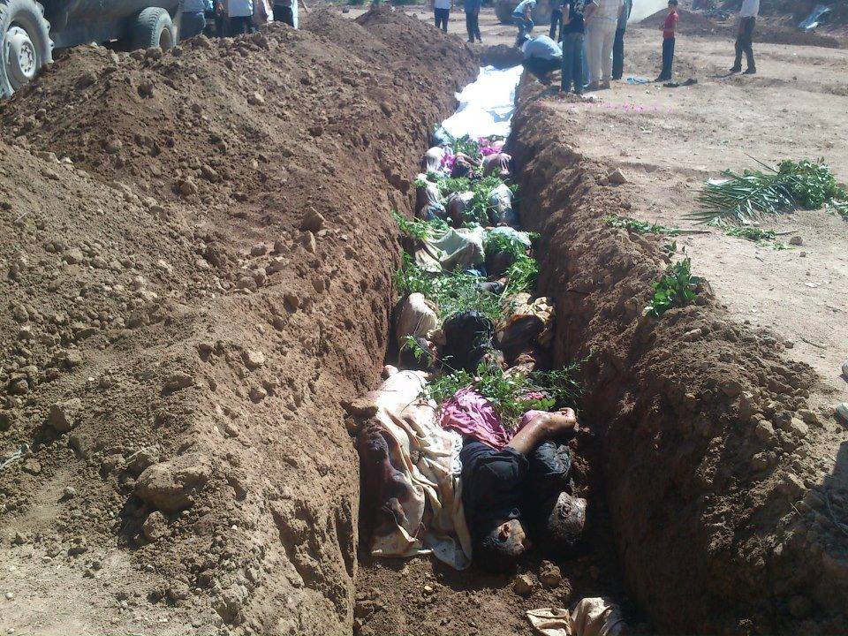
Darraya Massacre

Slide 10
Darraya Cemetery

Slide 11
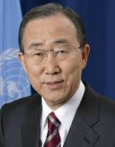
Responsibility
The UN Secretary General has condemned “the appalling and brutal crime” in the town of Daraya, calling for an inquest into the reported killing of more than 700 people in 26th of August 2012
ban ki moon

Slide 12
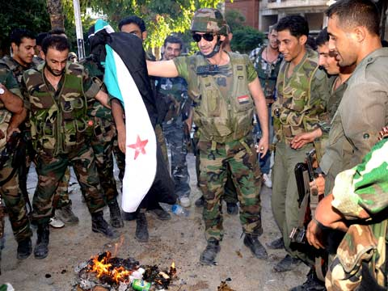
Justice and Accountability

Slide 13
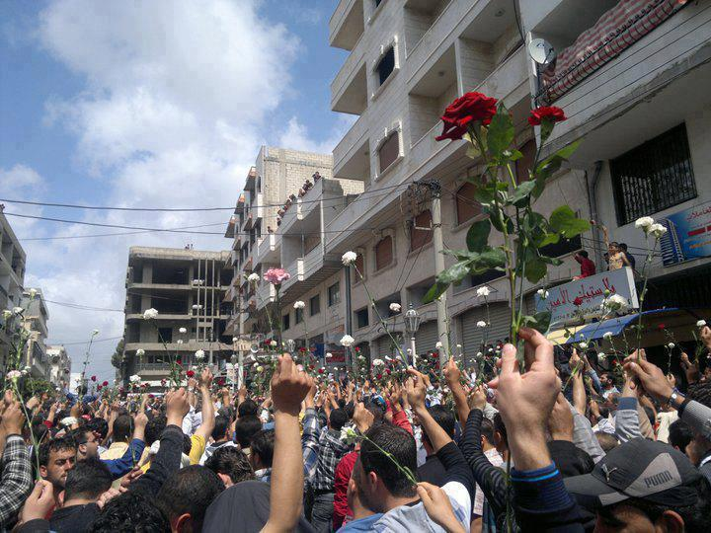
Peaceful uprising

Slide 14
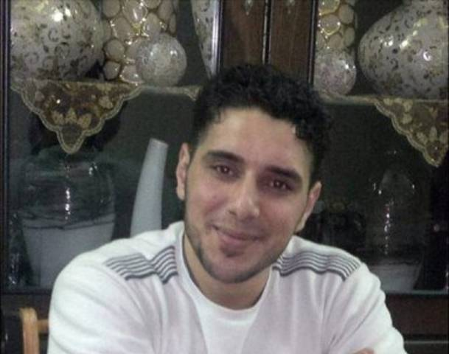
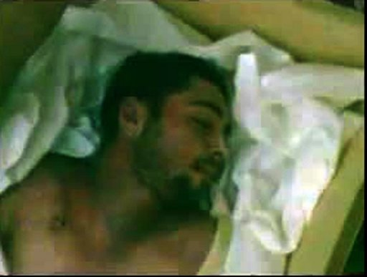
Little Gandhi Ghiyath Matar
Ghiyath Matar was killed under torture in the dungeons of the prisons of Syrian Air Force Intelligence. His body was delivered to his family on September 10, 2011, three days after he was arrested.
In Darayya, Ghiyath Matar was regarded as a hero, an inspirational organizer of anti-government rallies whose passionate commitment to nonviolence earned him the nickname “Little Gandhi.”

Slide 15
Ammar Rahawi, Der el-Zore How the gun killed the guitar

Slide 16
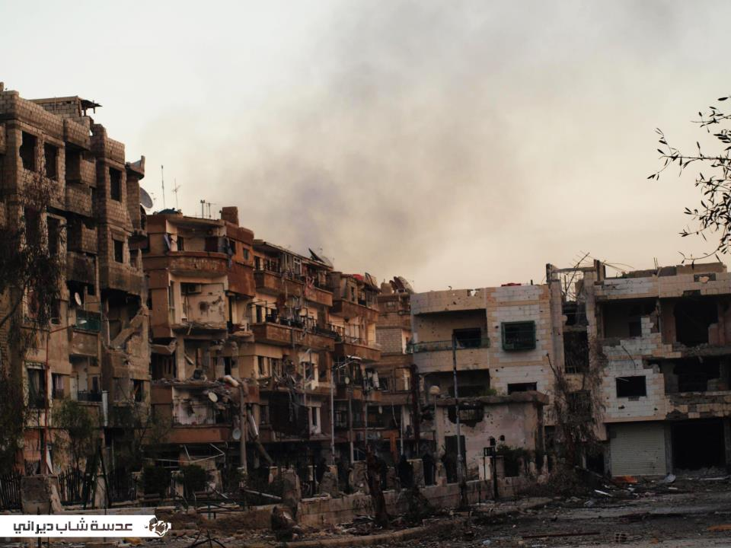
Darayya today...

Slide 17
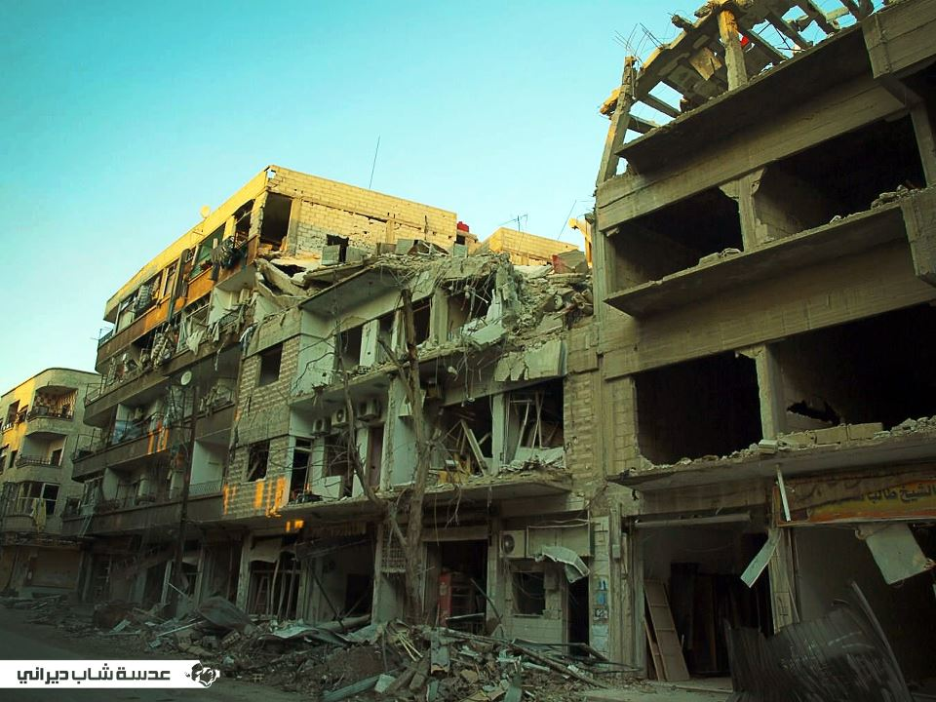

Slide 18
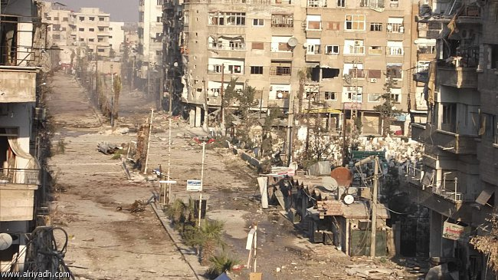

Slide 19
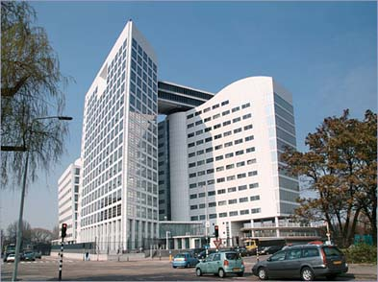
International Justice

Slide 20
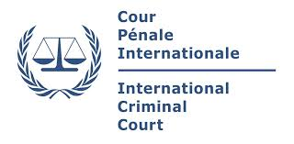
International Criminal Court

Slide 21
Responsibility to Protect

Slide 22
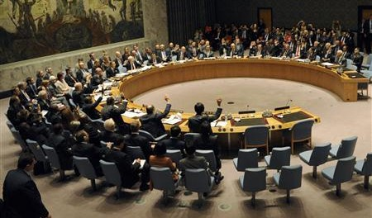
Responsibility to Protect

Slide 23
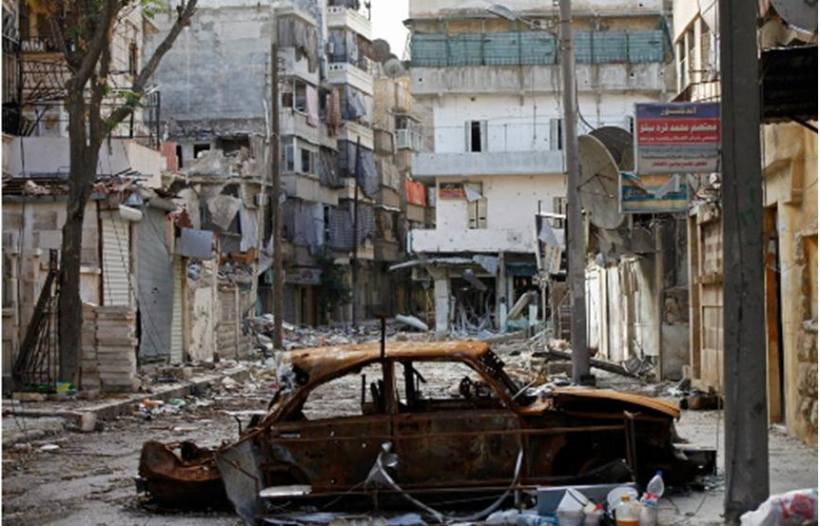
Nour Kelse Aleppo, 2012 Neighborhood

Slide 24
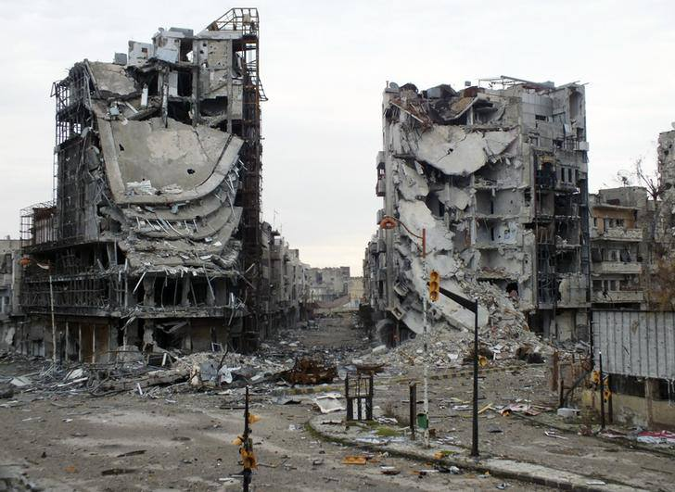
Nour Kelse Aleppo, 2013 Apartment Buildings

Slide 25
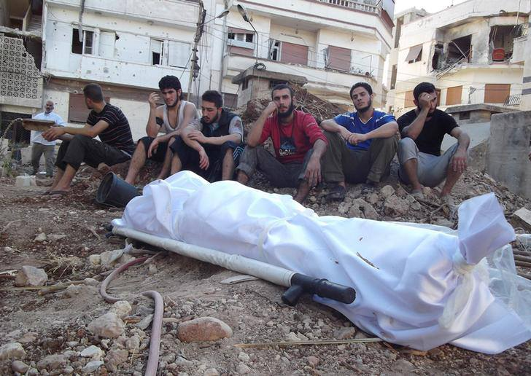
Nour Kelse Aleppo, 2013 Civilian Death

Slide 26
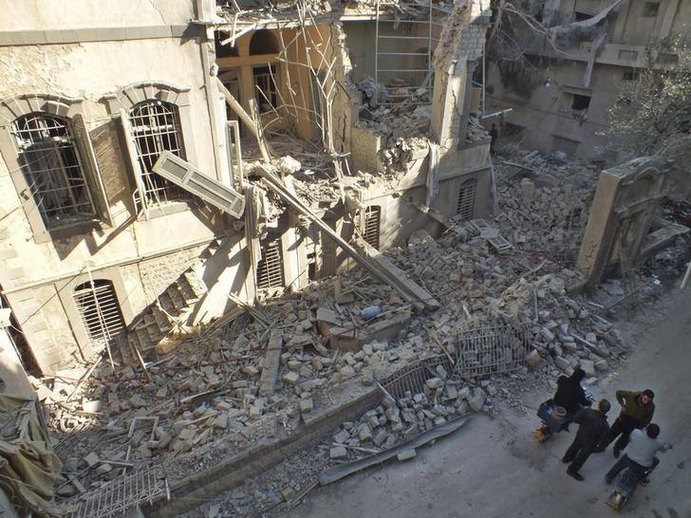
Nour Kelse Aleppo, 2013 Assessing Damage

Slide 27
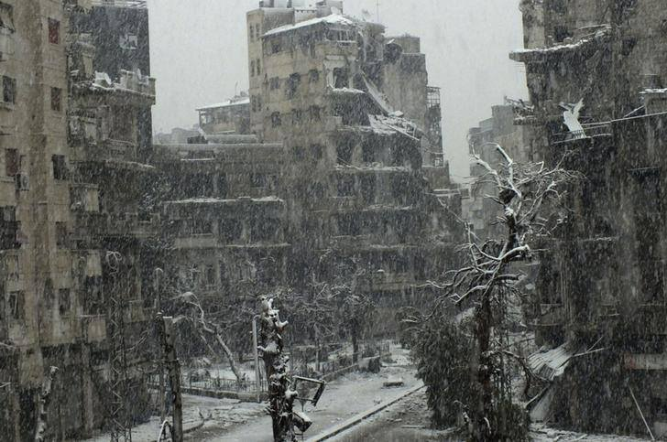
Nour Kelse Aleppo, 2013 Winter in Aleppo

Slide 28
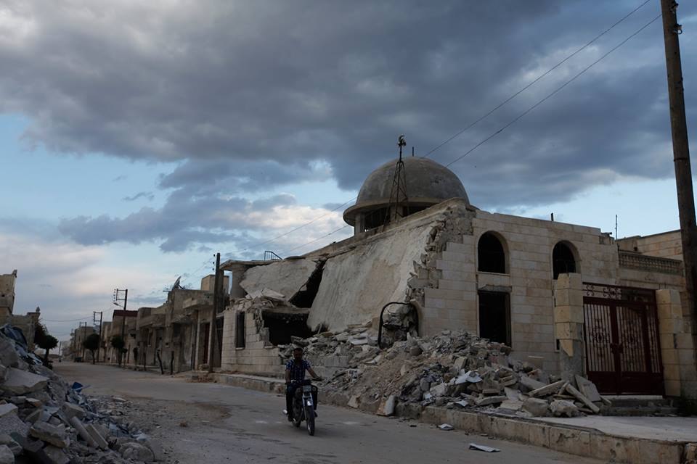
Nour Kelse Aleppo, 2013 The Mosque

Slide 29
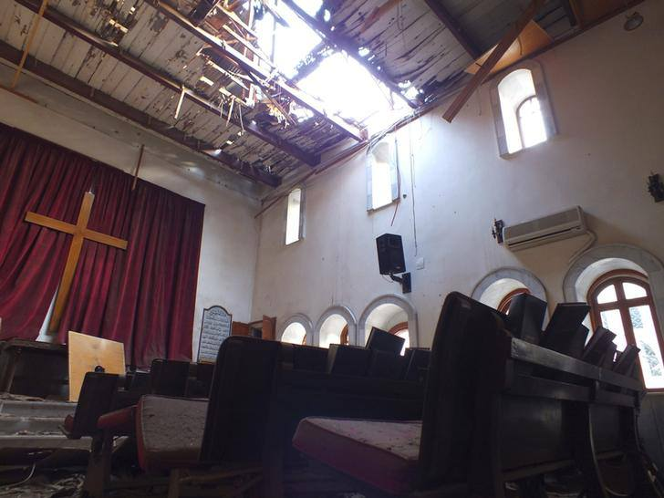
Nour Kelse Aleppo, 2013 The Church

Slide 30
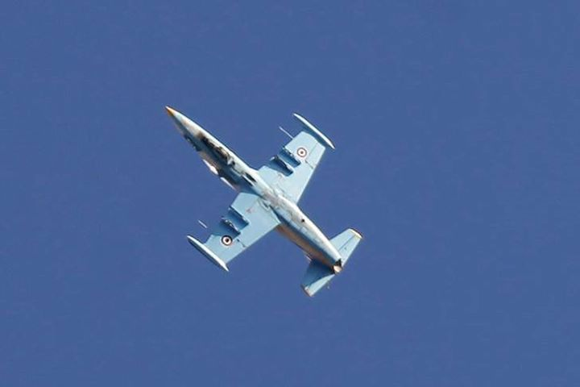
Nour Kelse Aleppo, 2013 The Regime War Plane

Slide 31
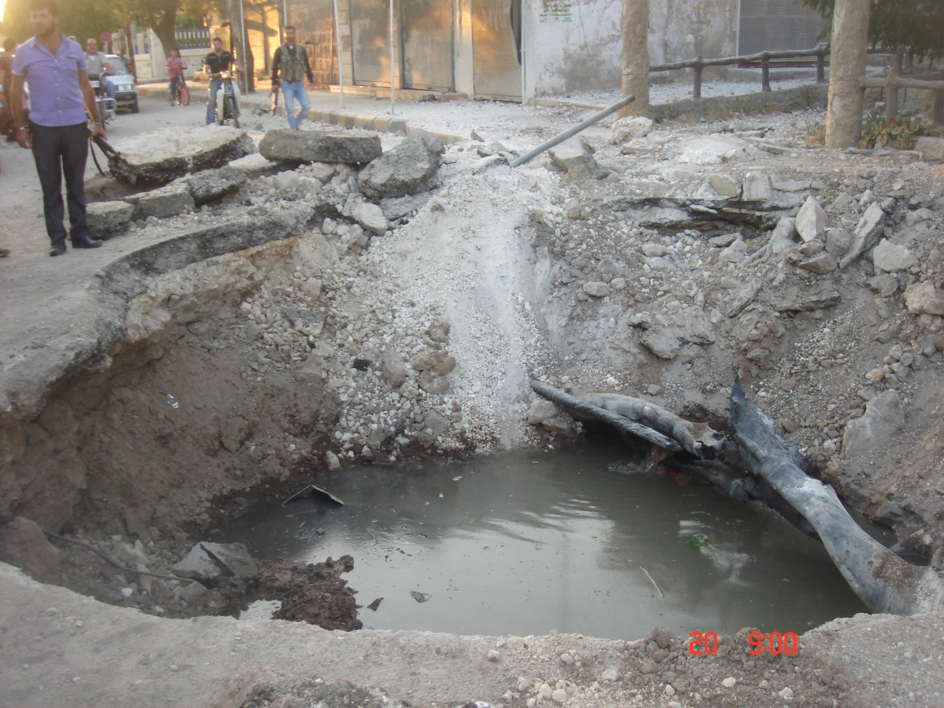
The Journey Home
Crater from long range missile strike. This picture is indicative of the level of damage done by the Assad regime to Syrian infrastructure. In this strike, the main water line in the city was destroyed.

Slide 32
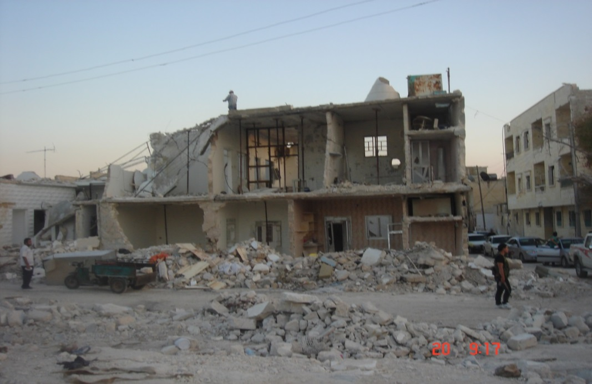
Destruction from regime strikes. In this strike, five buildings were completely destroyed leading to the death of 54 townspeople. An additional 100 people were injured.
Dr. Radwan Ziadeh ~ The Journey Home

Slide 35
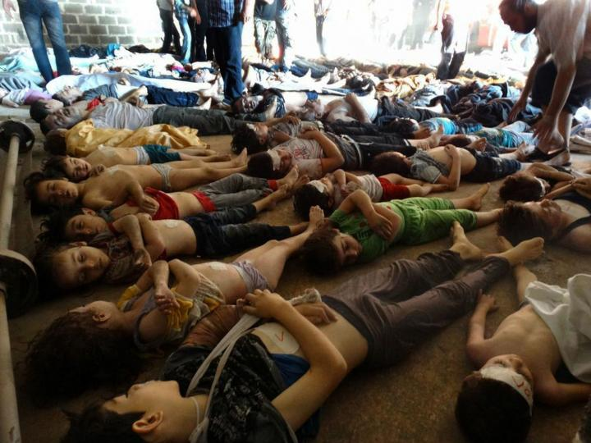

Slide 51
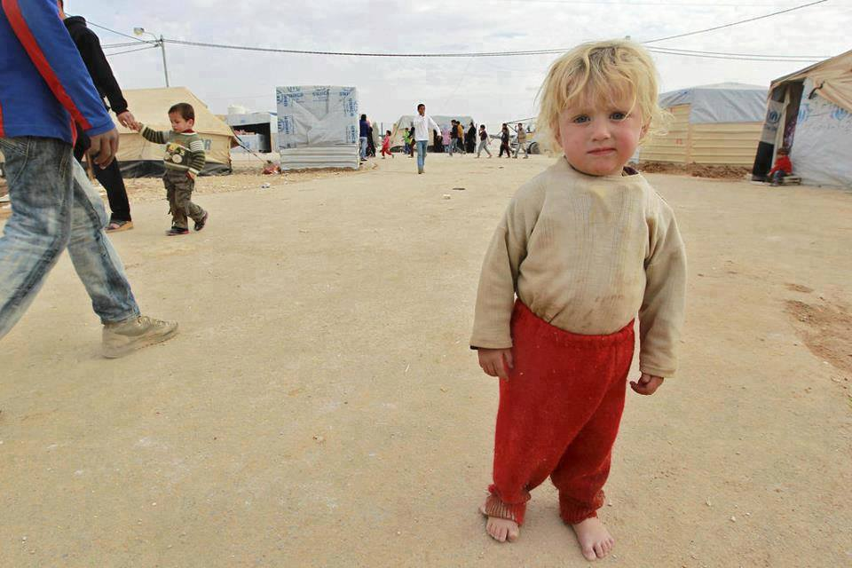
The Children of Syria 2013 FaDi Zayada

Slide 52
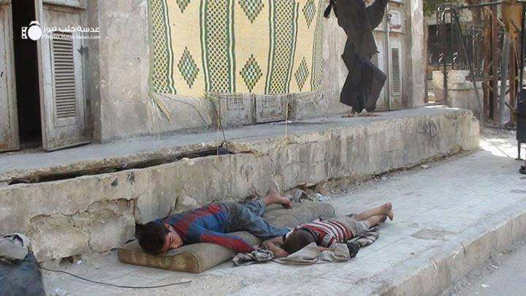
The Children of Syria 2013 FaDi Zayada

Slide 53
Rise of ISIS

Slide 54
Clinton on ISIS: 'Failure' to Help Syrian Rebels Led to the Rise of ISIS

Slide 56
Syria Transition Roadmap

Slide 57
Recommendations for the future

Slide 58
Reconciliation in Divided Society

