Slide 1
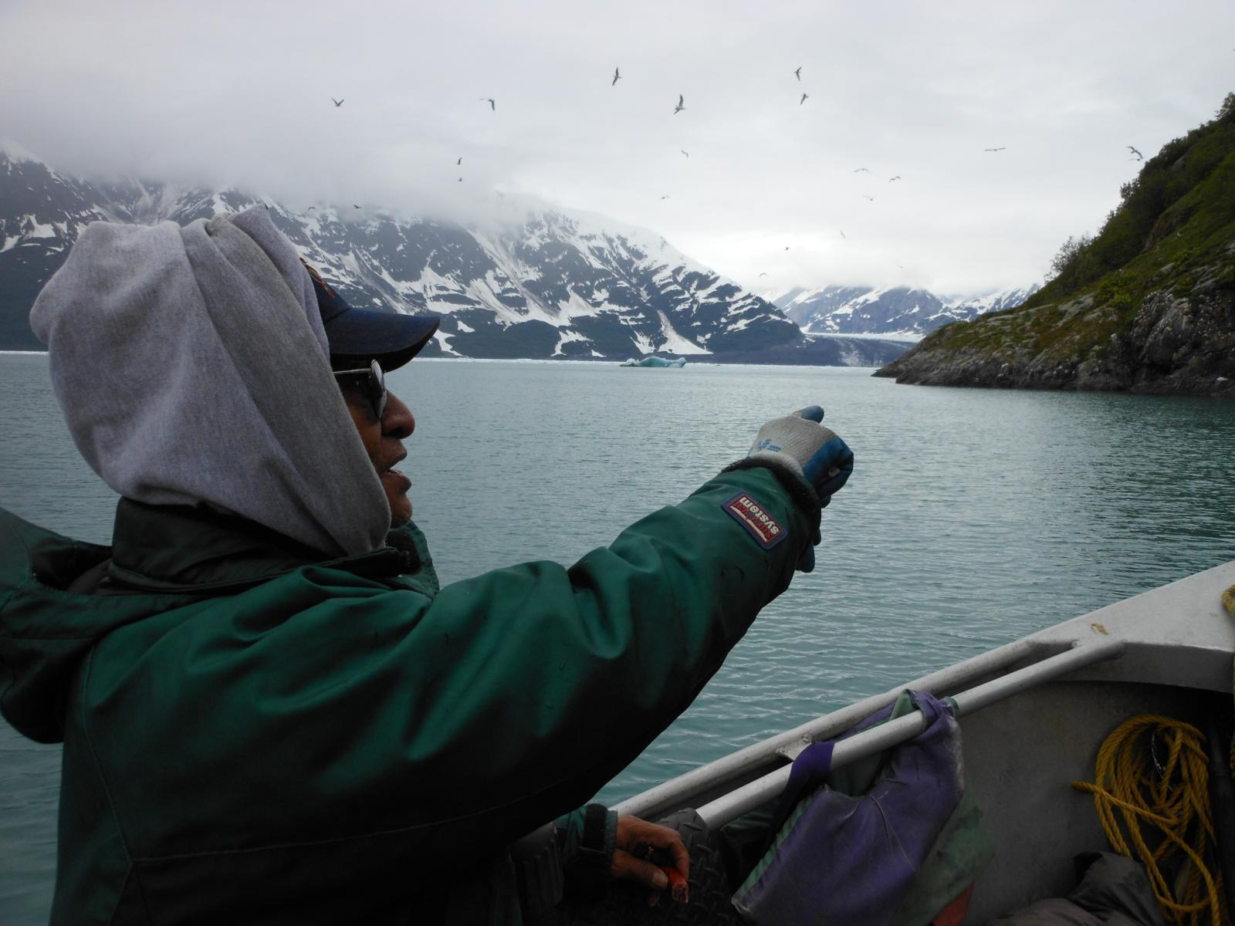
At the Glacier’s Edge: The Peopling and
History of Yakutat Bay since A.D. 1000
National Science Foundation , Arctic Social Sciences Program
2011 EAGER grant 1132295; 2012 Research Grant 1203417

Slide 2
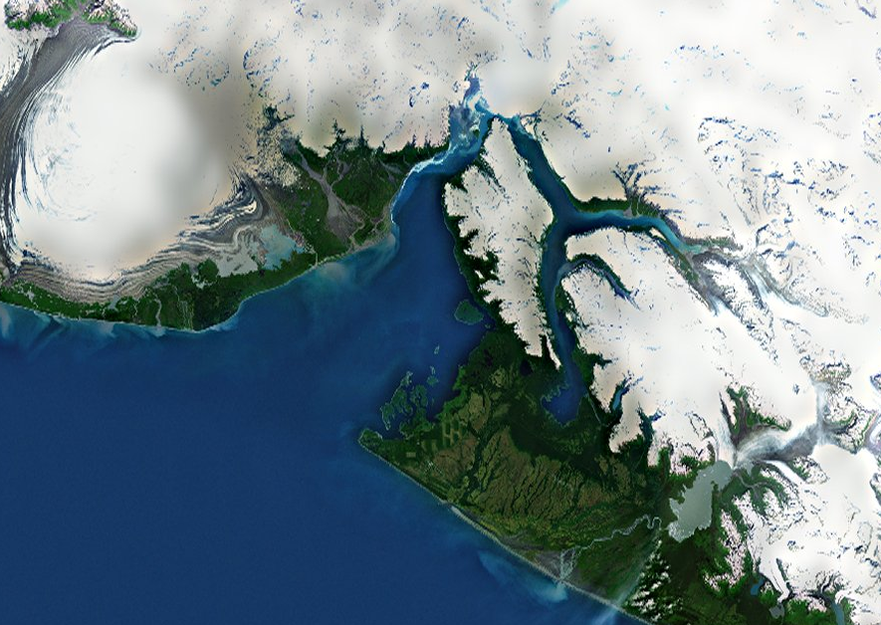
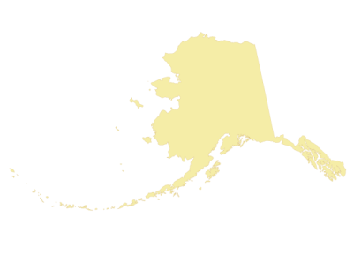
Hubbard
Glacier
Malaspina
Glacier
Disenchantment
Bay
Yakutat Bay
Yakutat
Yakutat
Foreland
Alaska
Yakutat Bay
Yakutat Bay

Slide 3
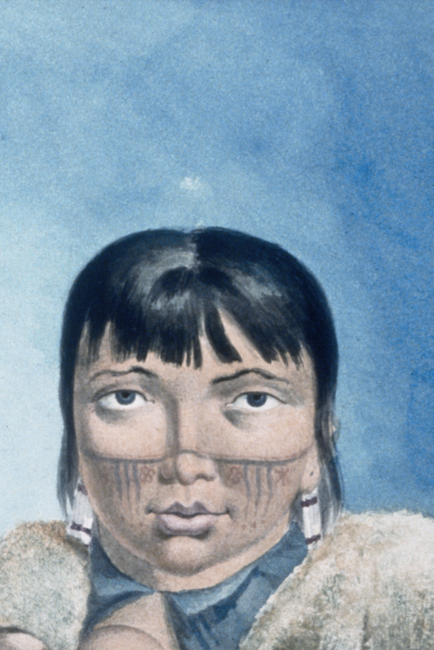
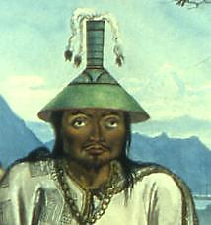
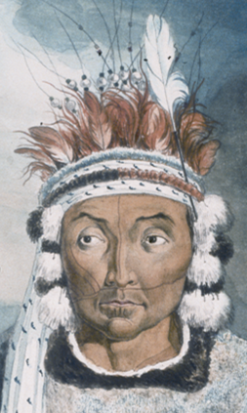
Migrations to Yakutat Bay
Eyak – about A.D. 800
Ahtna – about A.D. 1500
Tlingit – about A.D. 1750

Slide 4
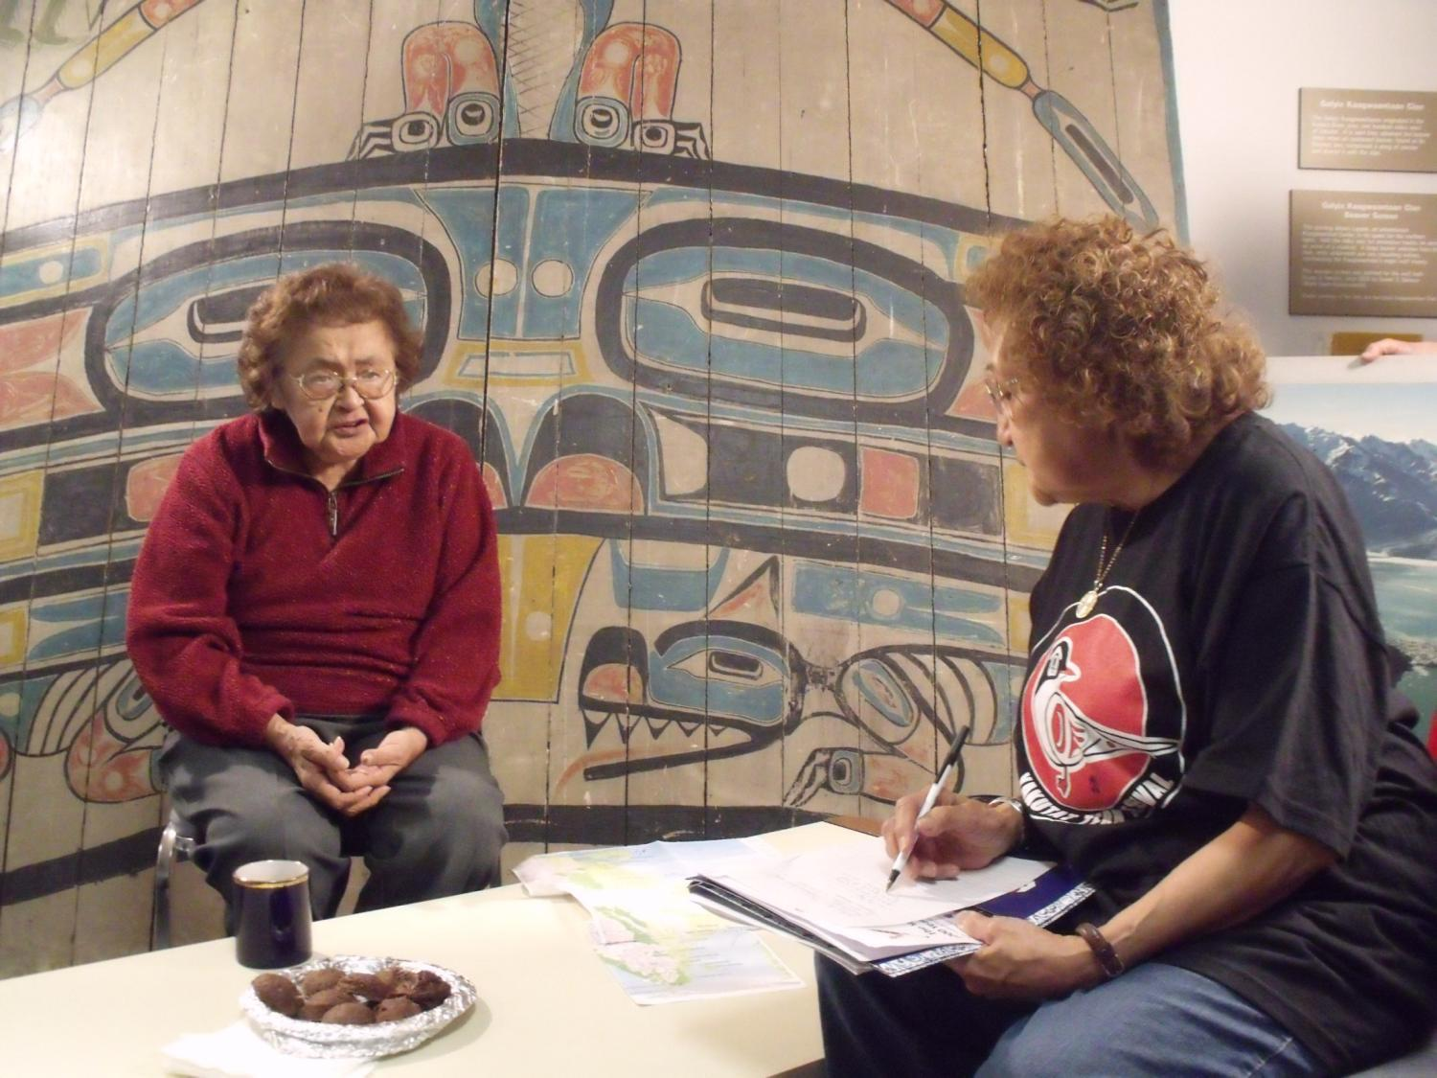
Oral history interview with Lena Farkas (left)
and Elaine Abraham (right)

Slide 5
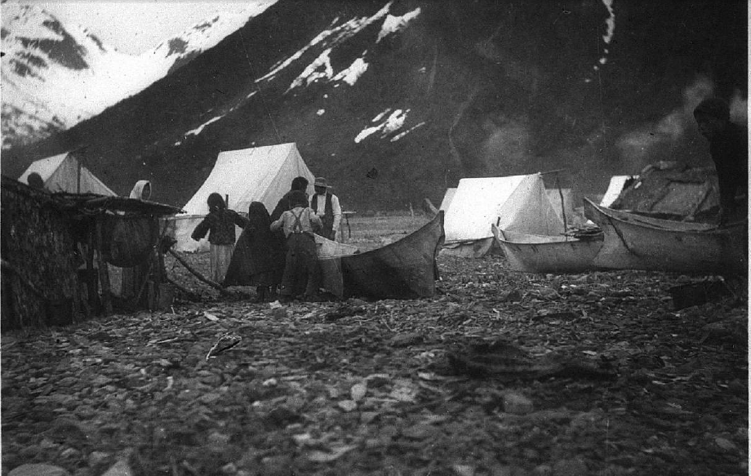
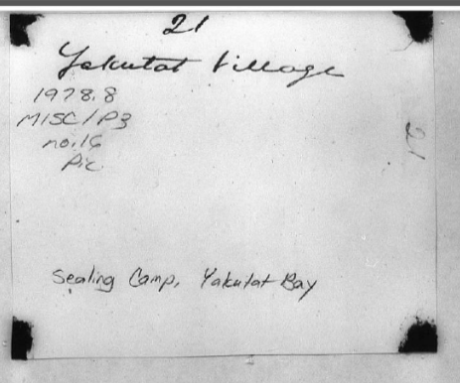
C. Hart Merriam photo album at the Bancroft Library, Berkeley,
photograph of Yakutat sealing camp in 1899

Slide 6
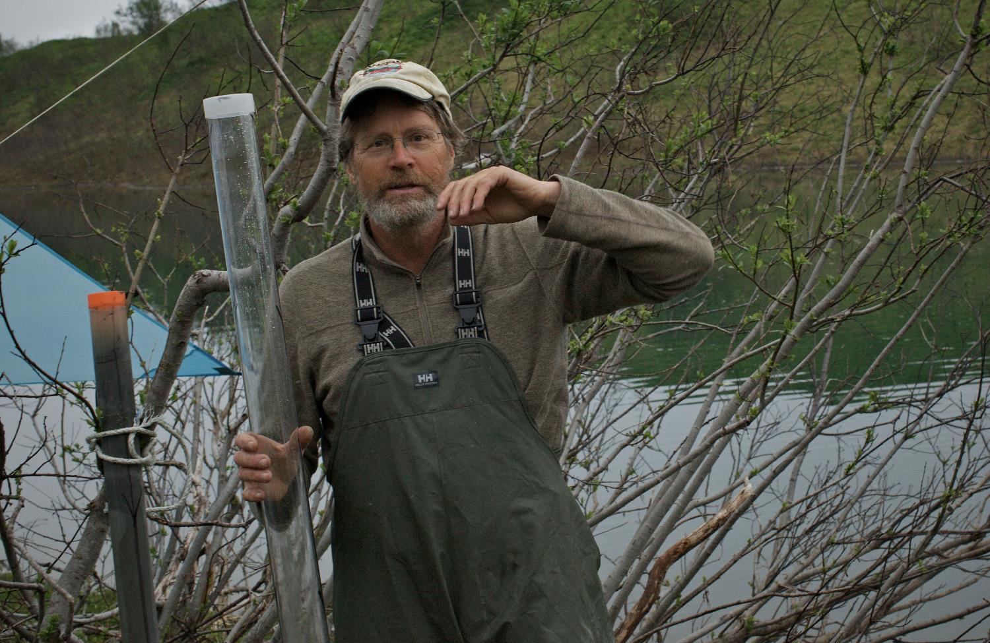
UAF geologist Daniel Mann with lake core, used to interpret
the history of glacial retreat

Slide 7
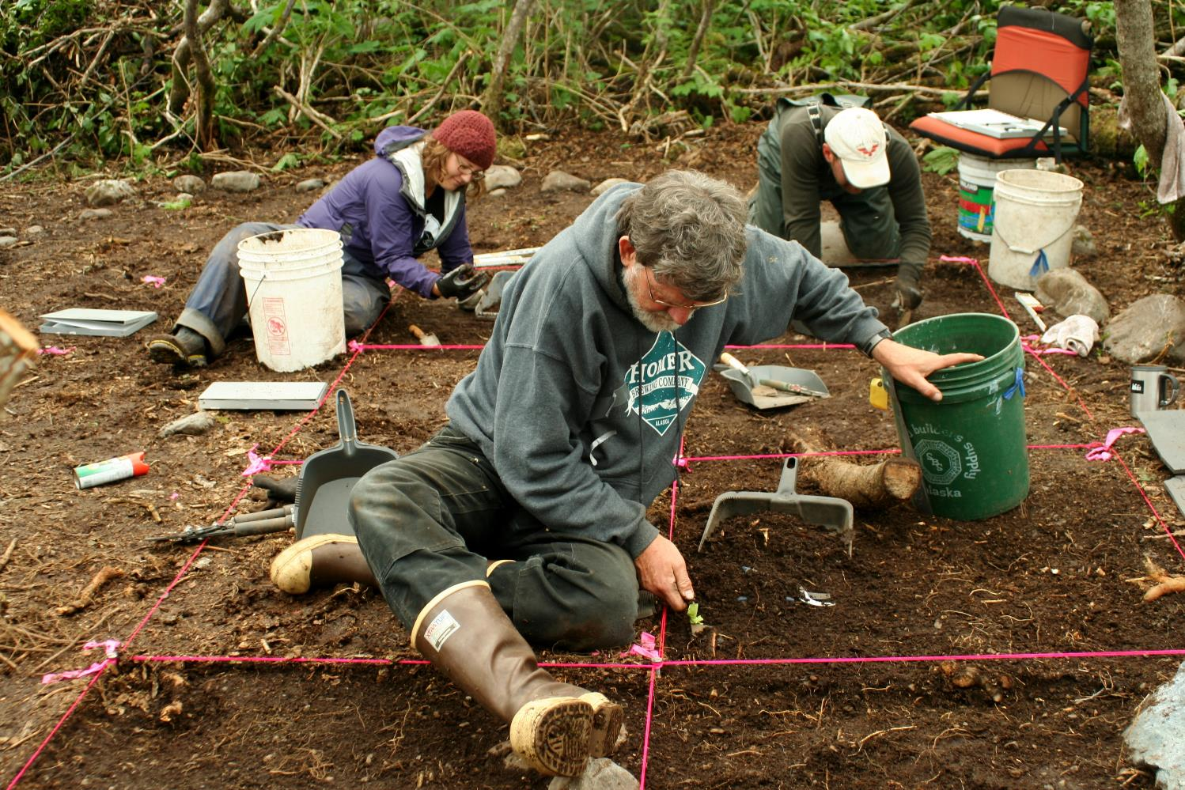
Archaeological excavations at Qek’otliya / Shaanáx Kuwóox’ sealing camp
at Indian Camp Creek, 2013

Slide 8
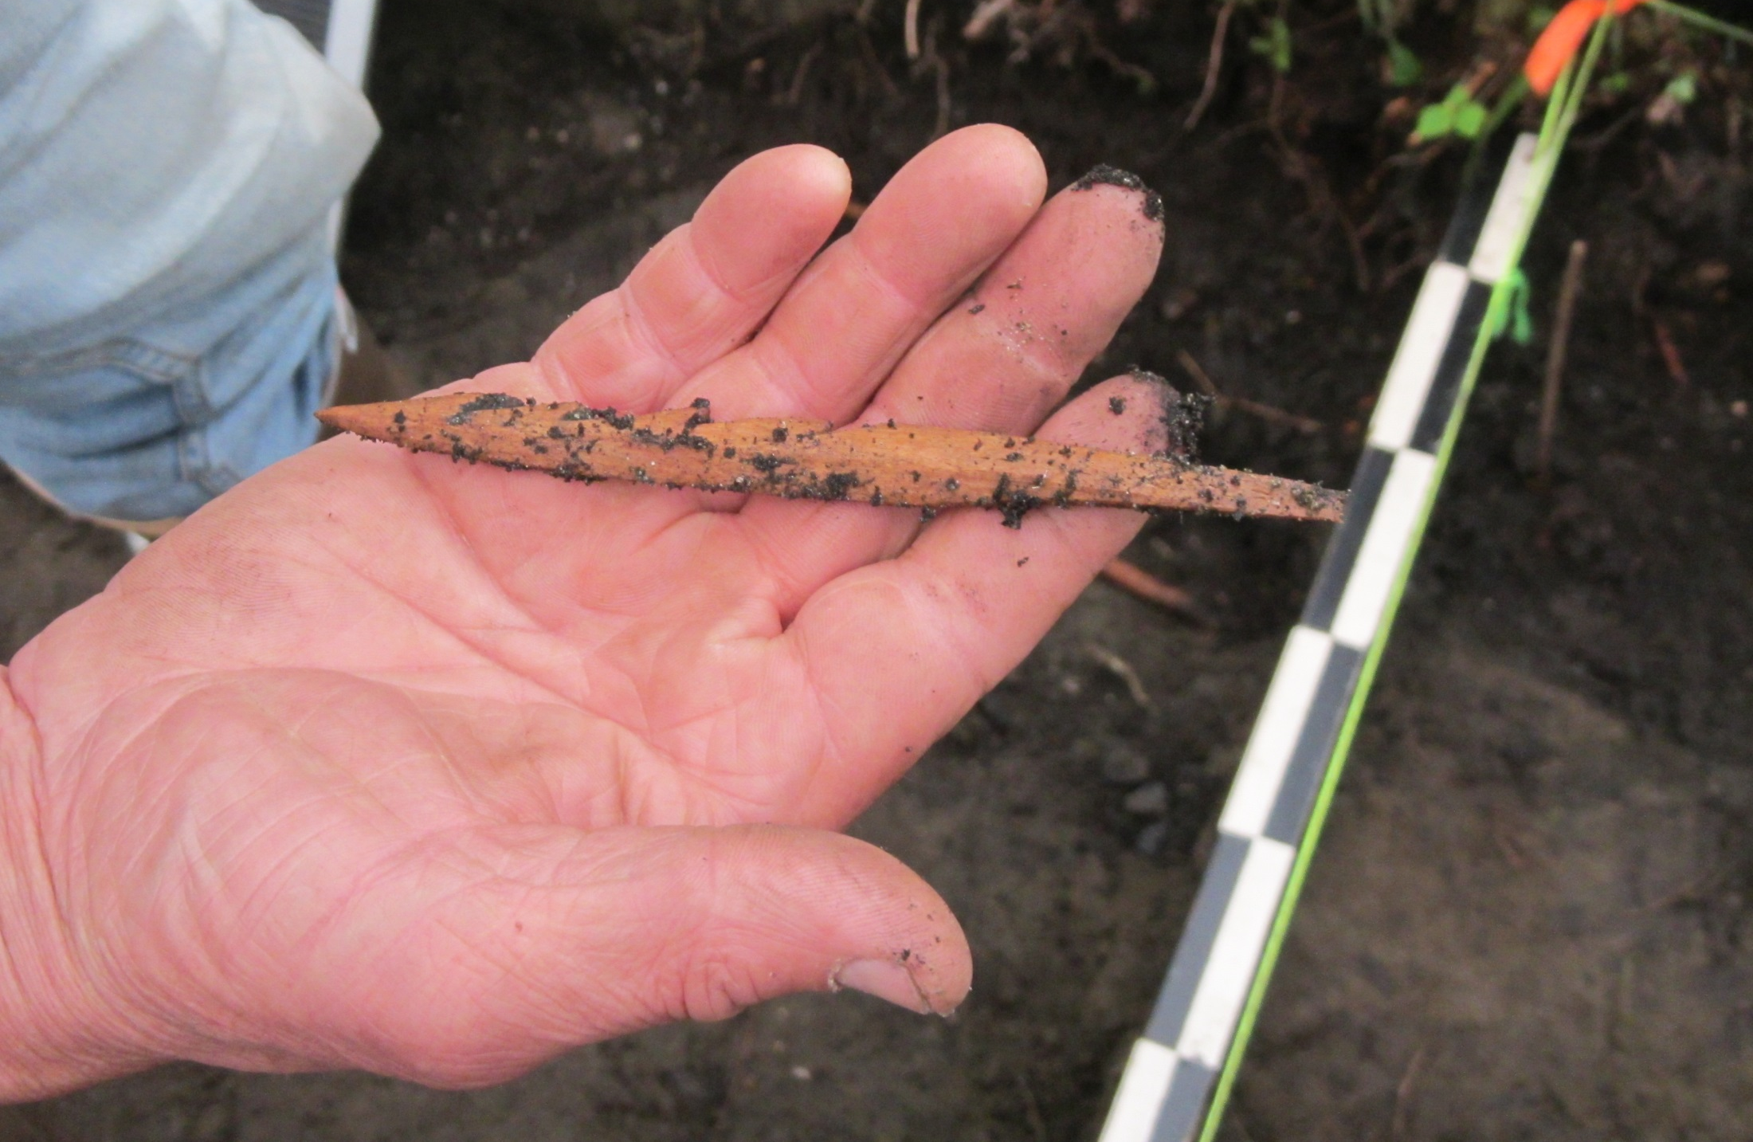
Arrow point from the Tlákw.aan (Old Town) site on Knight Island

Slide 9
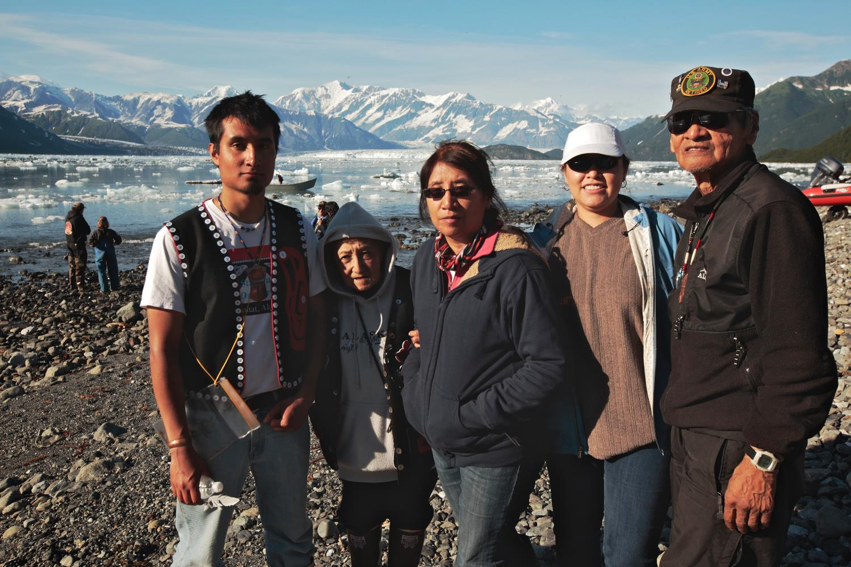
Ramos – Abraham family on traditional Gineix Kwáan land
at Disenchantment Bay, 2013

Slide 10
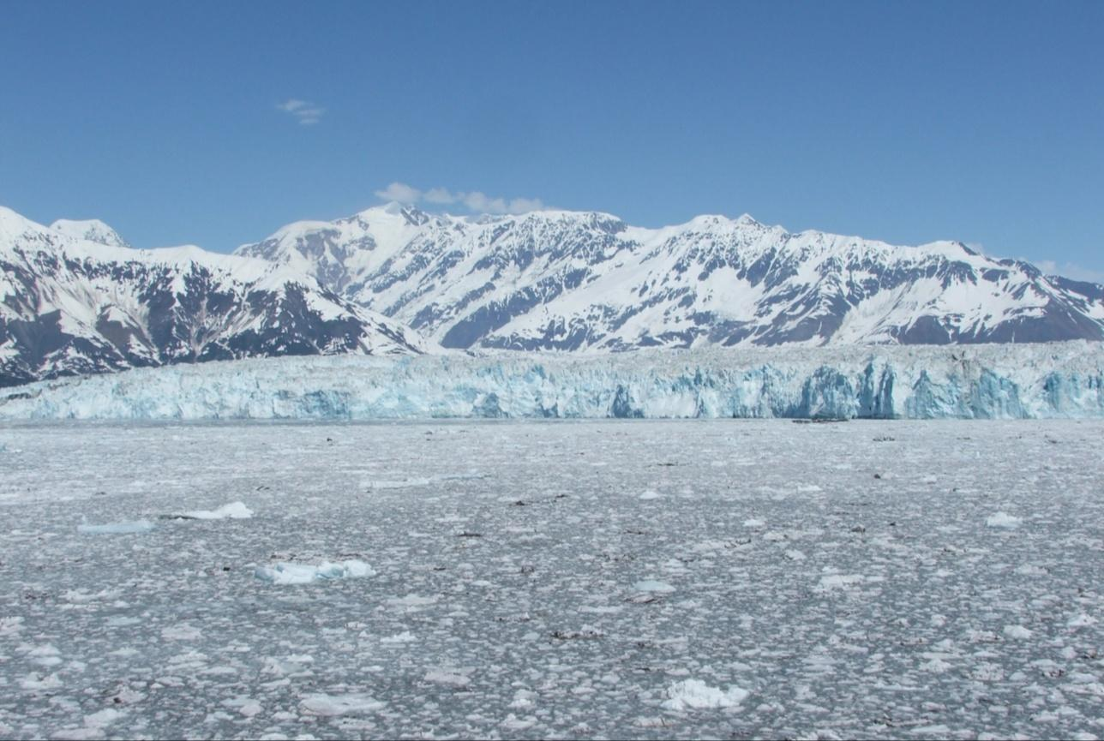
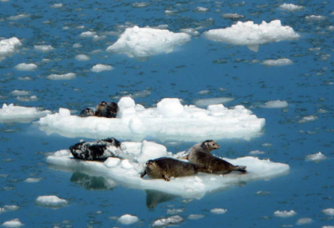
Harbor seals on spring ice floes at Hubbard Glacier

Slide 11
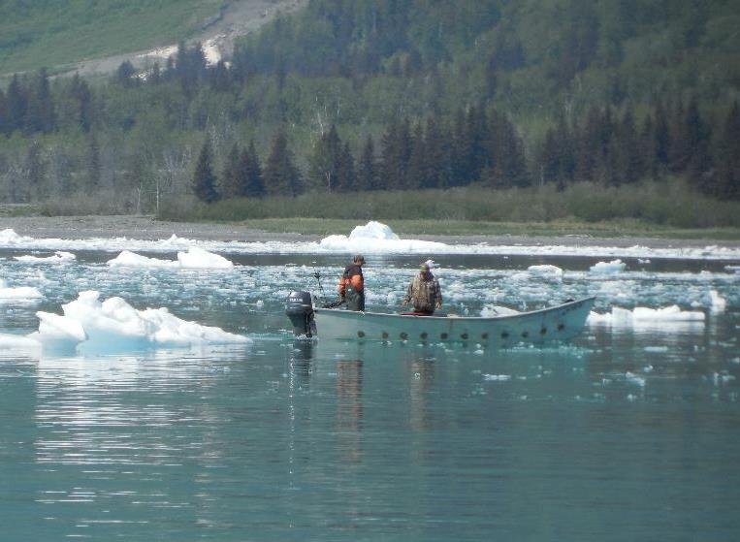
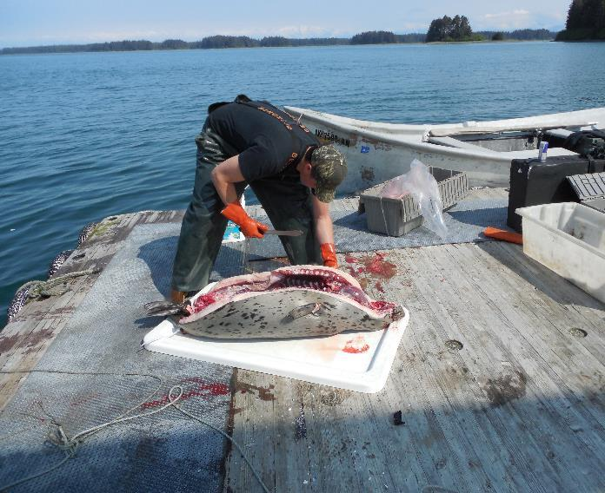
Sealing then…
1899
and now.
2014

Slide 12
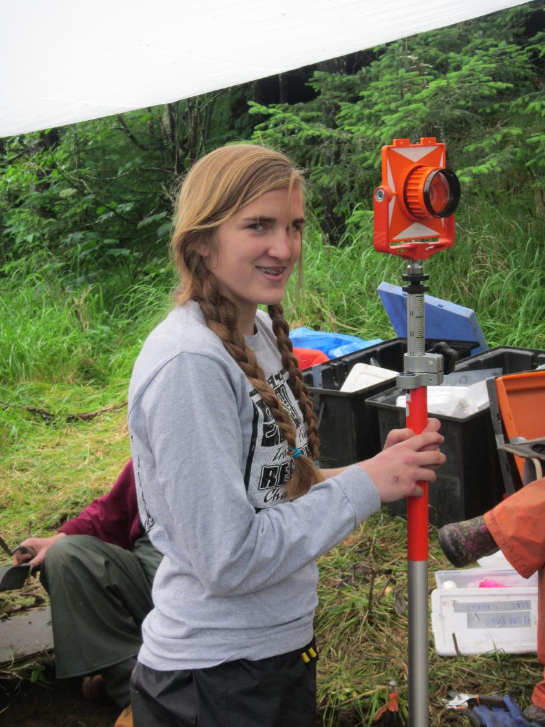
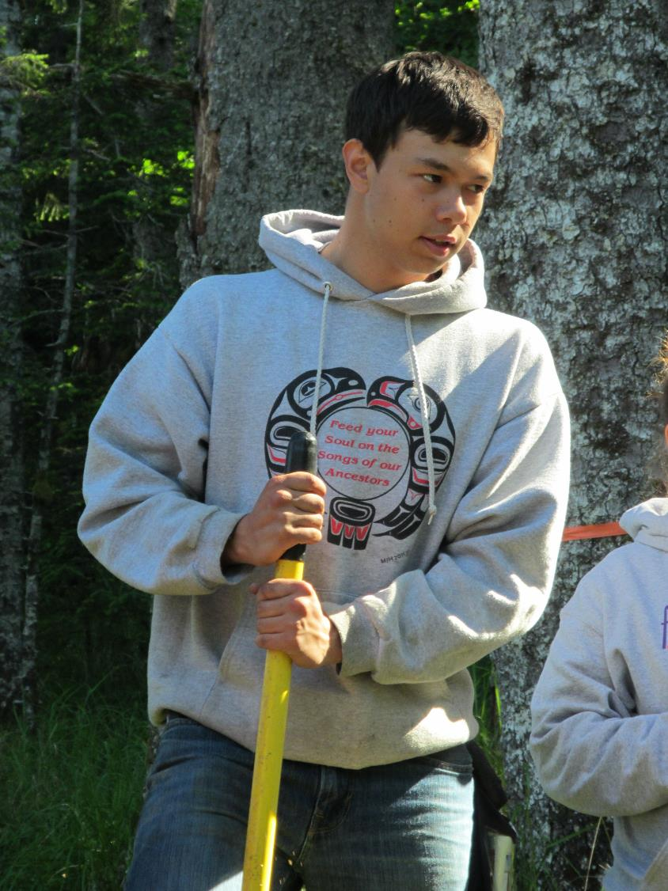
Devlin Anderstrom
Sarah Newlon

Slide 13
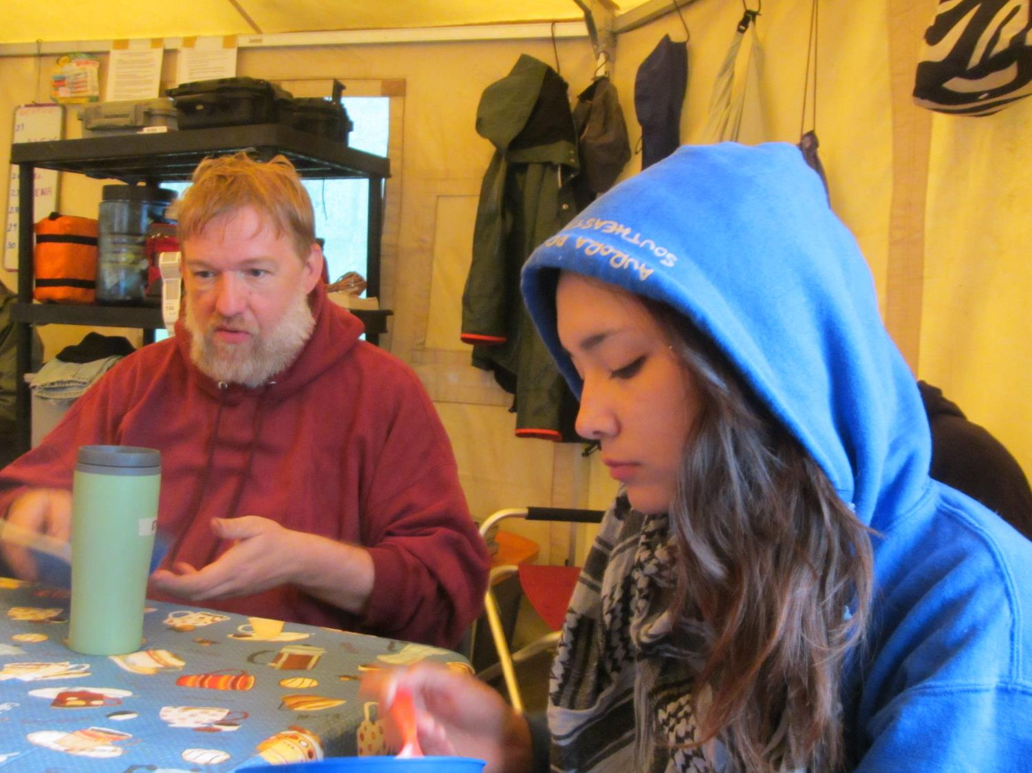
Daniel Thom
Maka Monture

Slide 14
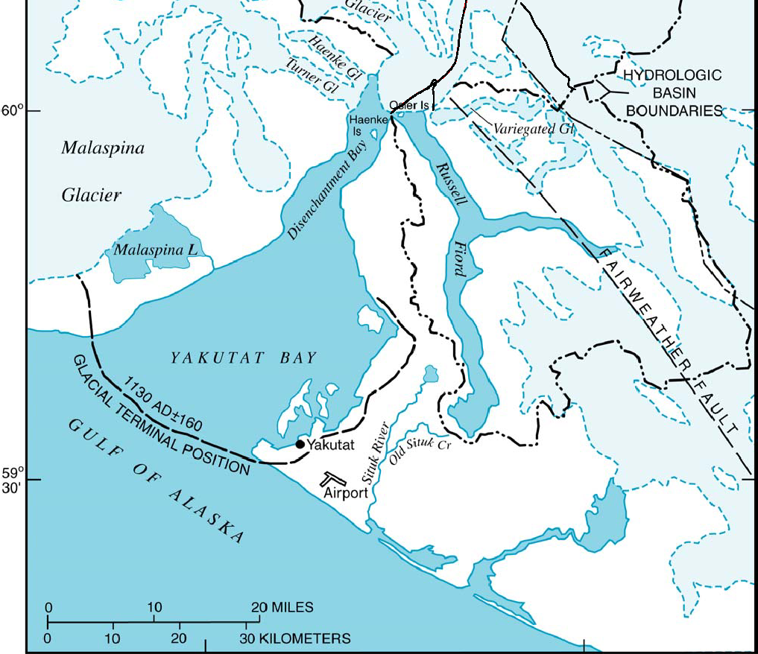
1890 AD
Spoon Lake 3
1400 AD
1275 AD
~1300 AD
~1130 AD
1218 AD
784 AD
Yakutat Bay glaciers and archaeological sites 1100 – 1300 A.D.

Slide 15
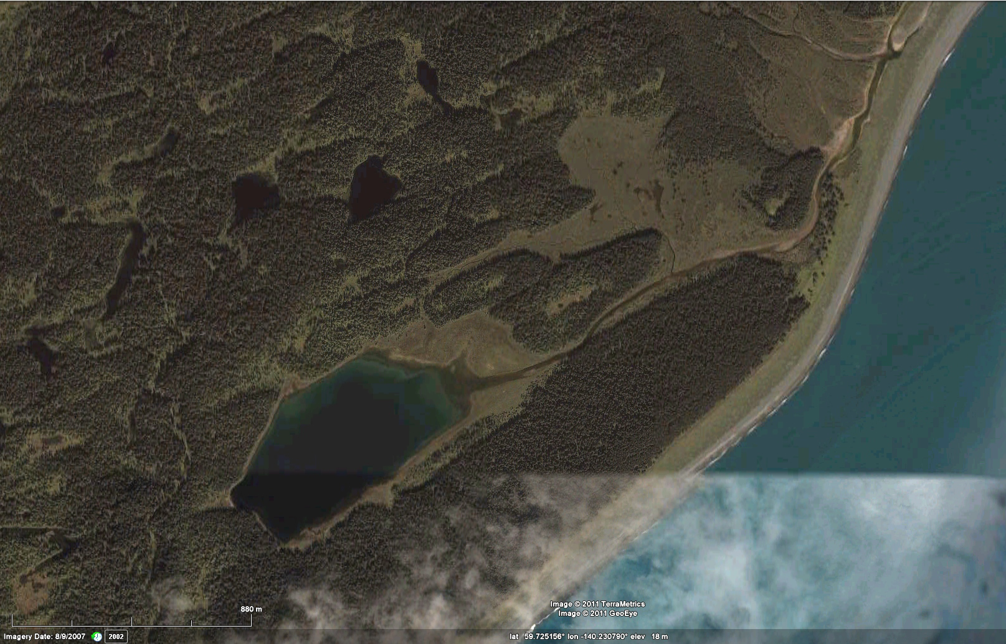
Malaspina Glacier
Approx. shoreline
Seals
Spoon Lake 3 site
Estimated glacier and shoreline positions during Spoon Lake 3 occupation

Slide 16
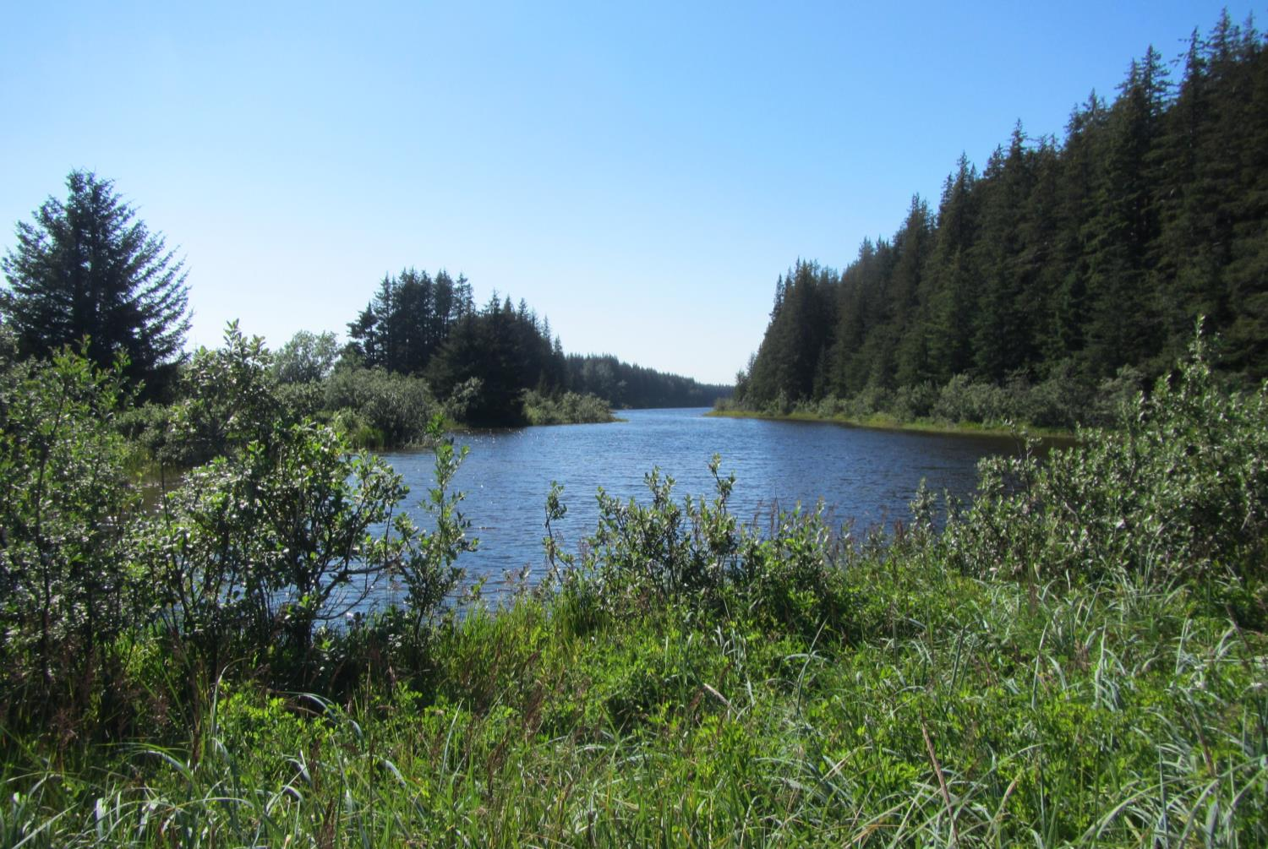
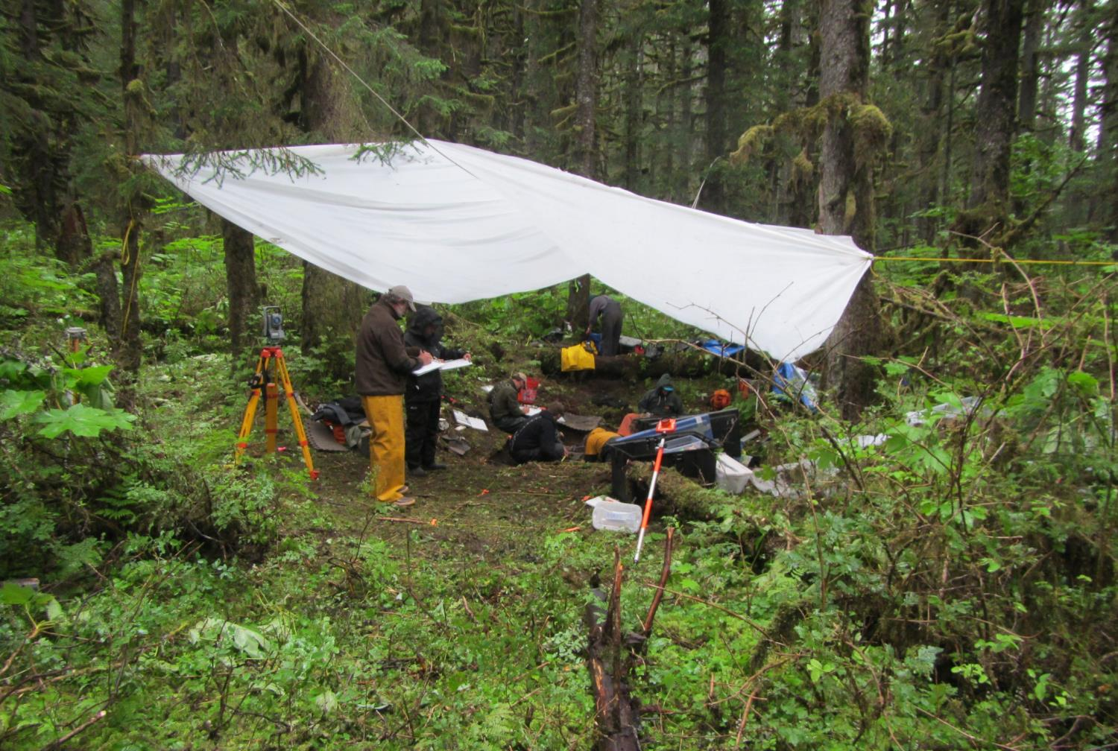
Spoon Lake and the Spoon Lake 3 site

Slide 17
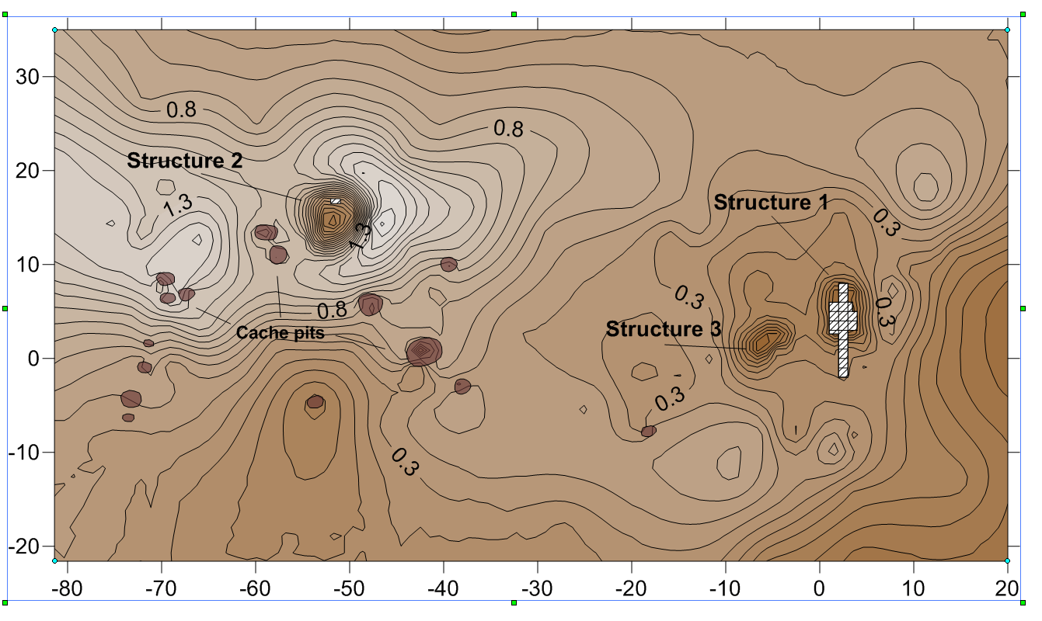
Summer house group?
Deep winter house with caches
Spoon Lake 3 (YAK-076)

Slide 18
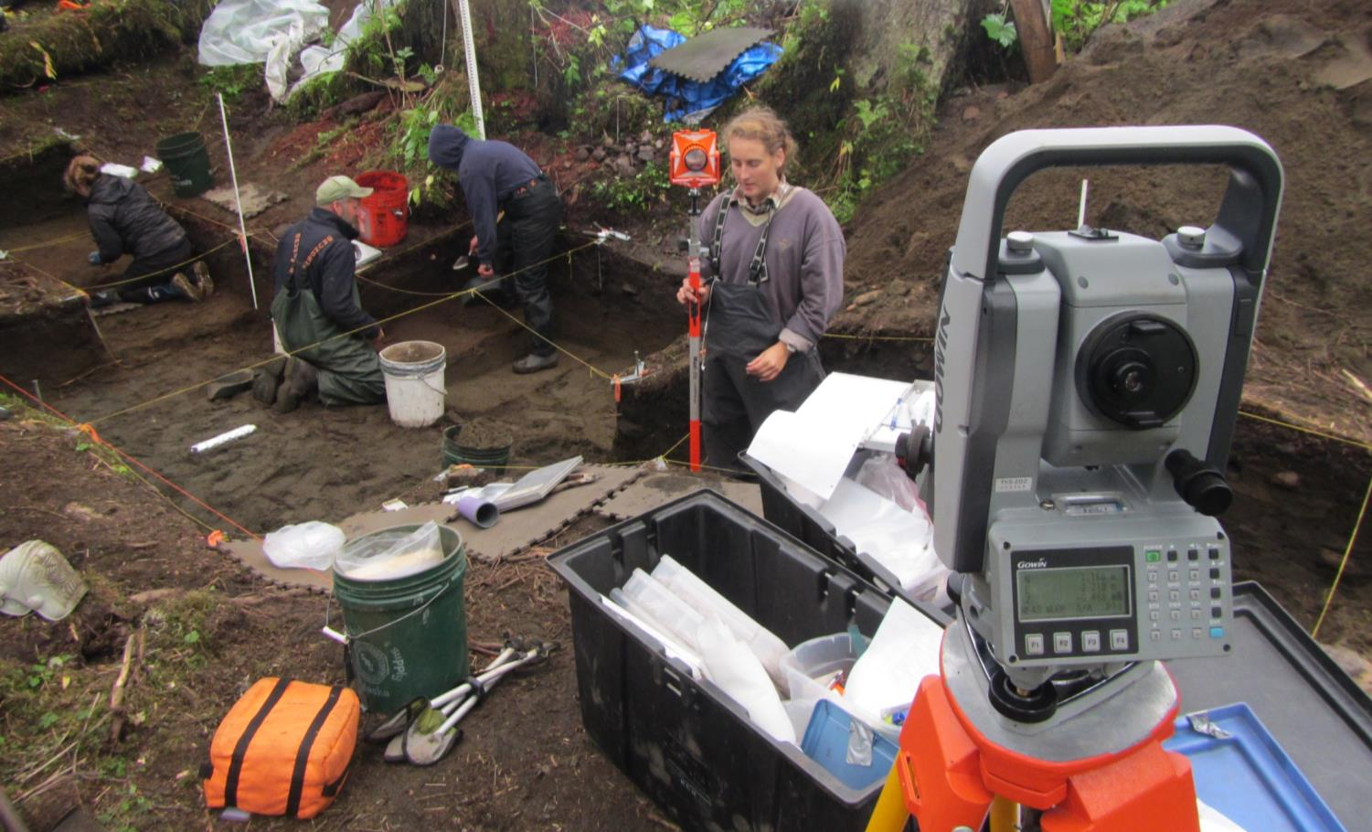
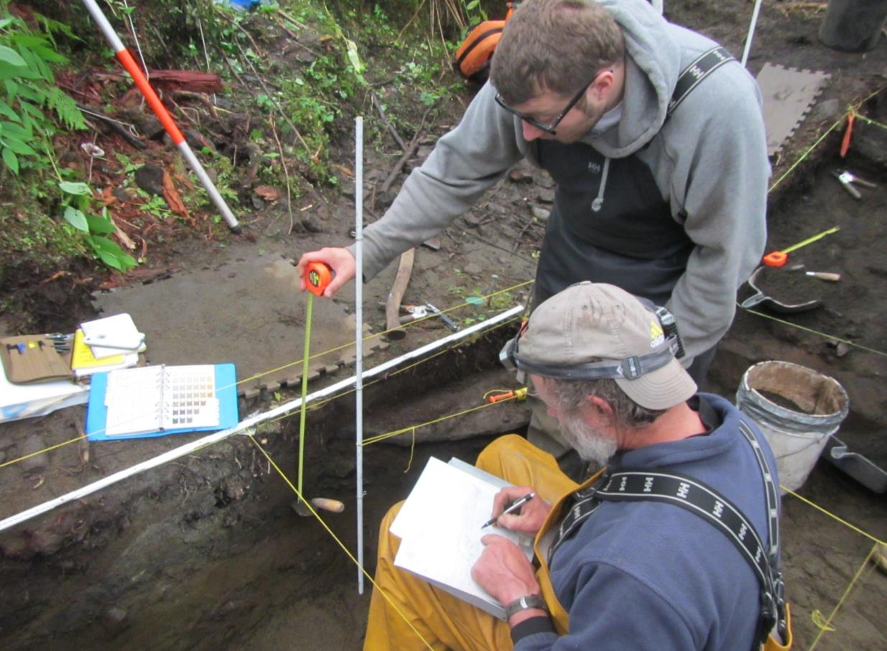
Excavating and mapping Structure 1, Spoon Lake 3

Slide 19
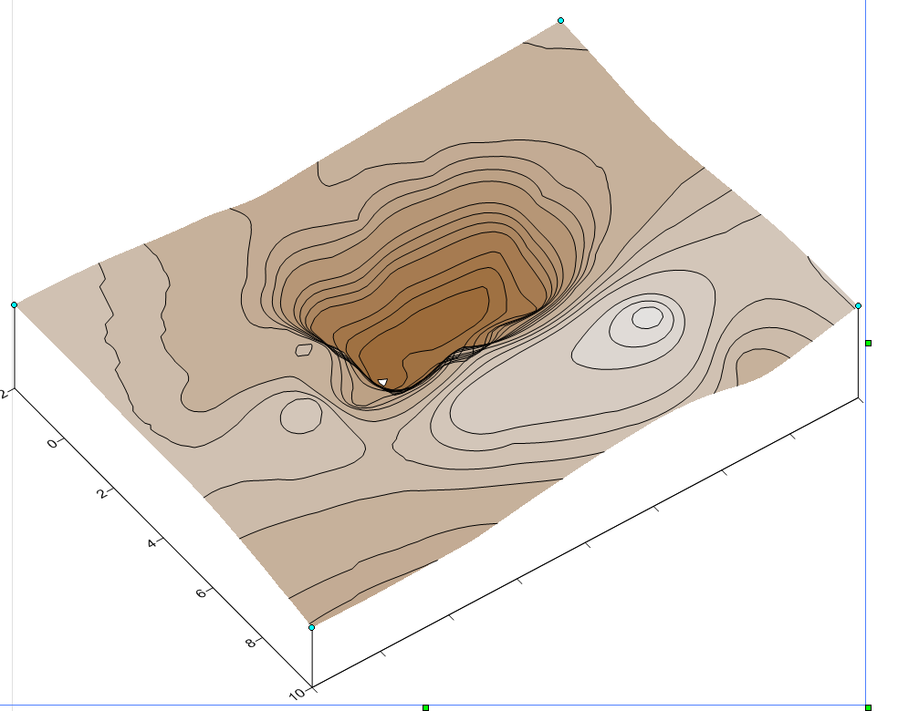
Smudge
fires
Hearth
Sitting
rock
Outside hearths
Structure 1 at Spoon Lake 3: a dwelling/smokehouse

Slide 20
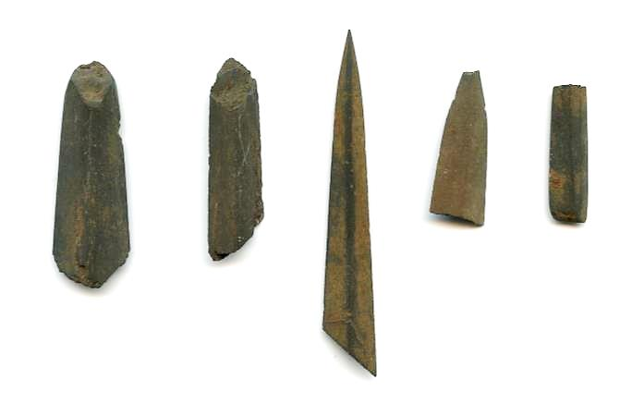
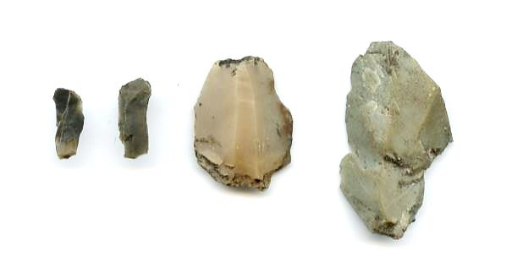
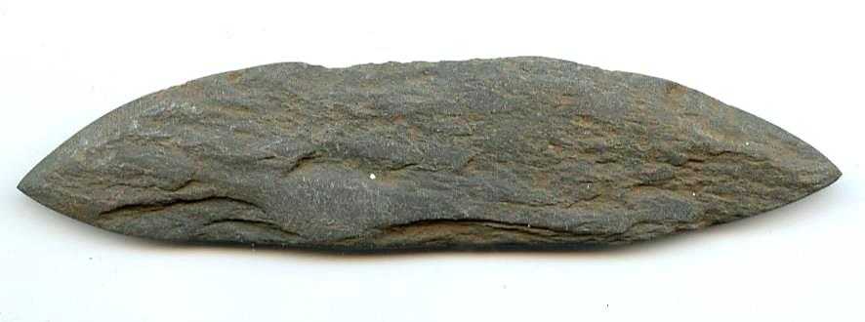
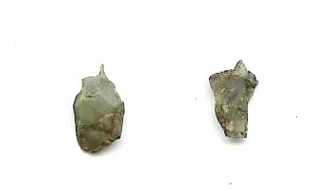
Chert microblades and cores
Ground slate projectile points
Chert micro awls
Greenstone chisel
Stone tools from the Spoon Lake 3 site, Structure 1

Slide 21
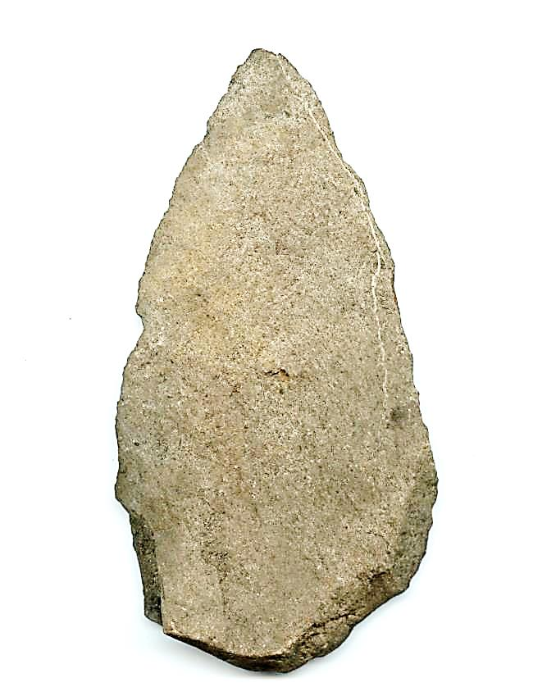
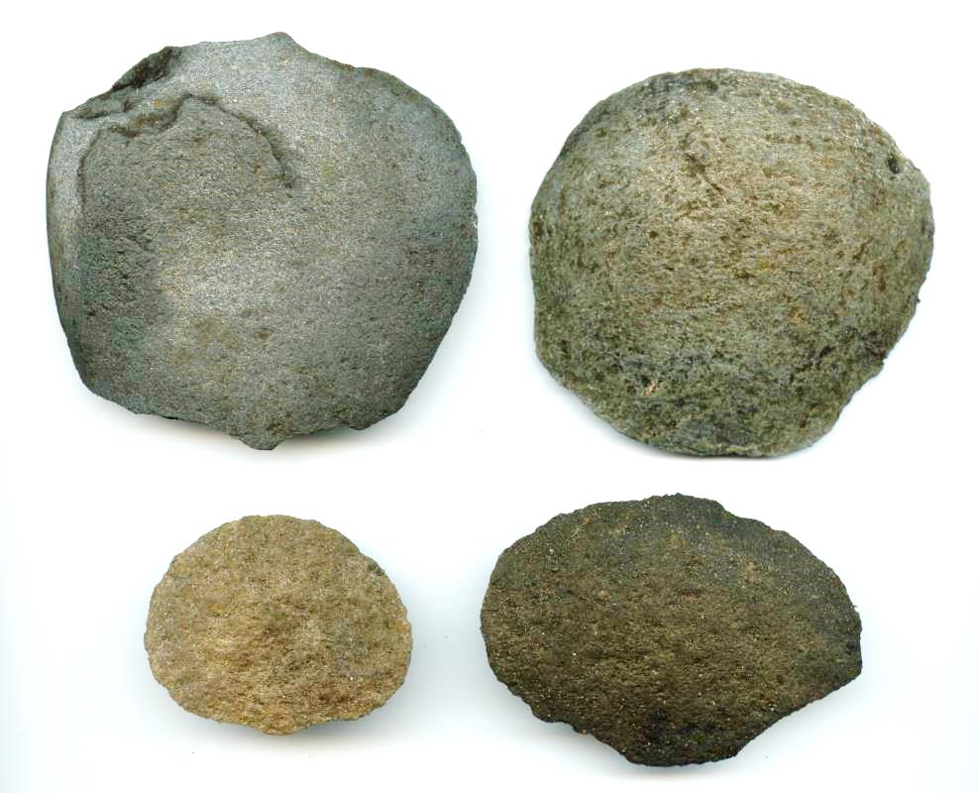
Large knife
Cobble spall scrapers

Slide 22
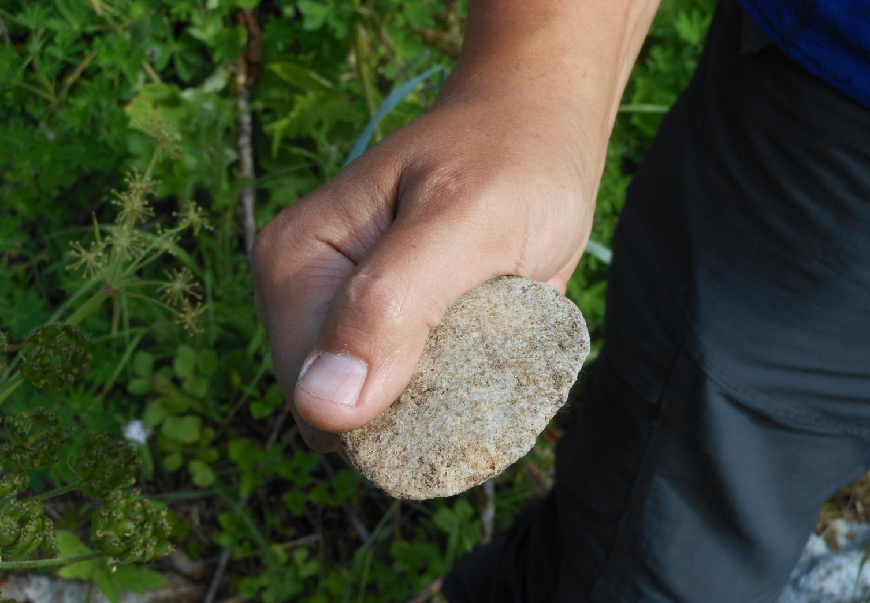
Cobble spall scraper used for processing seal skins

Slide 23
Present
glacier
1890s AD
1791 AD
1400 AD
Tlak.waan
1410 AD
1550 AD
1275 AD
~1300 AD
~1130 AD
1218 AD
784 AD
Yakutat Bay glaciers and archaeological sites ca. 1400 - 1550 A.D.

Slide 24
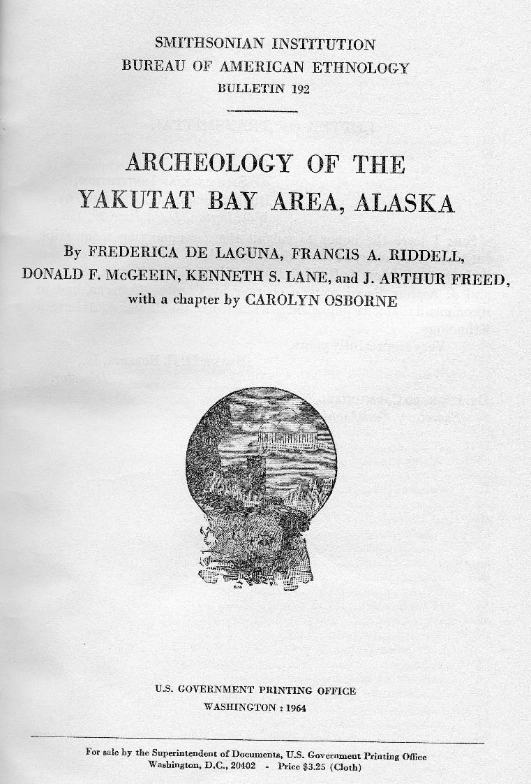
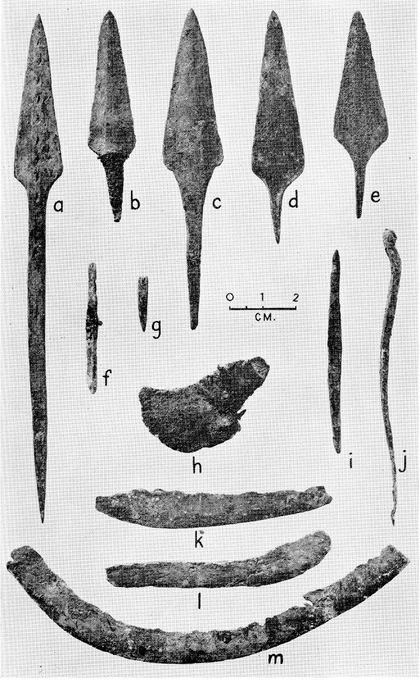

Slide 25
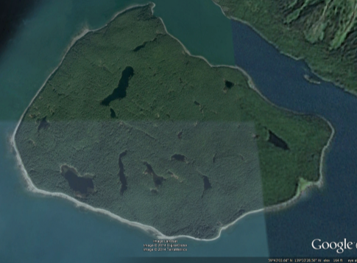
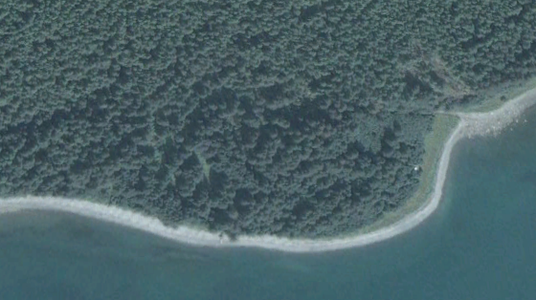
Ganawás
Knight Island
Village site
Houses and features
Mapped by De Laguna in 1949-52
30 additional houses
and features mapped in 2014
New discoveries at the Tlákw.aan (Old Town) site

Slide 26
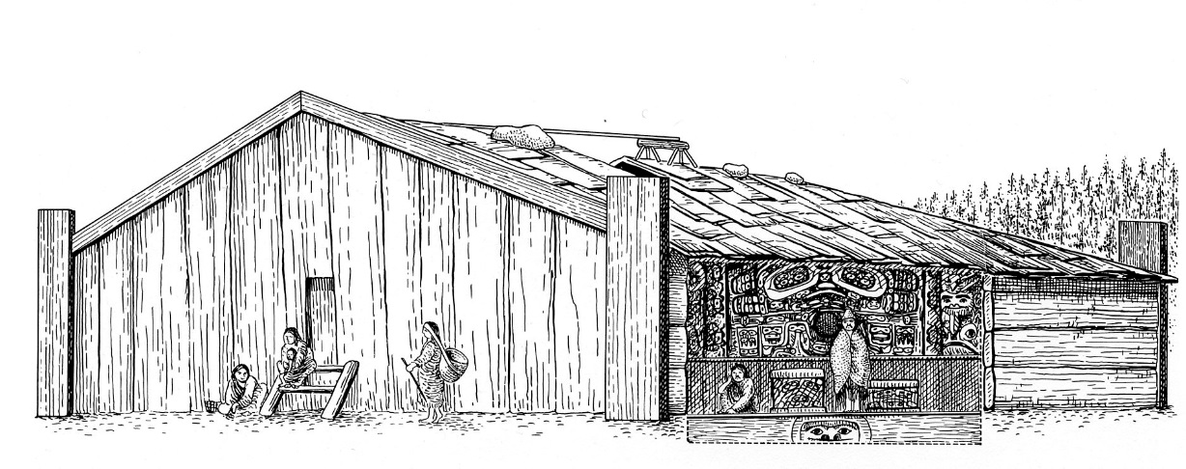
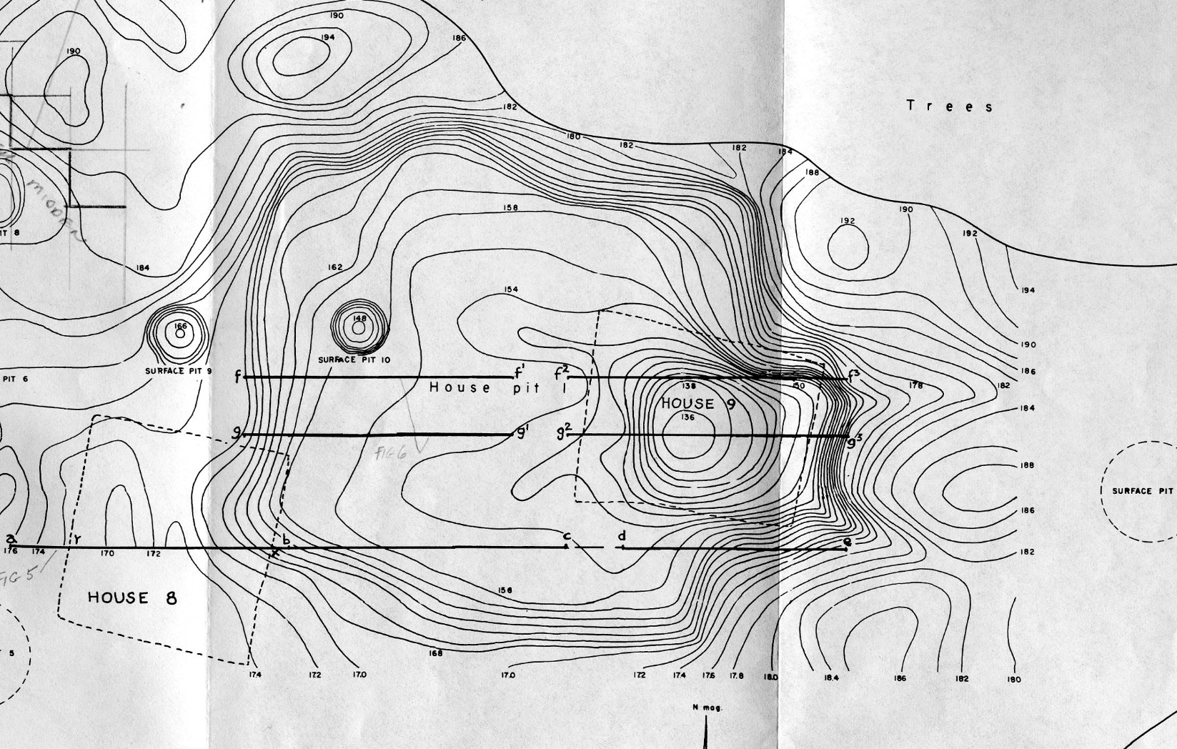
Northern Northwest Coast
plank house
2014 test trench in shell midden behind House 1
Archaeological “footprint” left by House 1 at Tlákw.aan
(De Laguna et al. 1964)

Slide 27
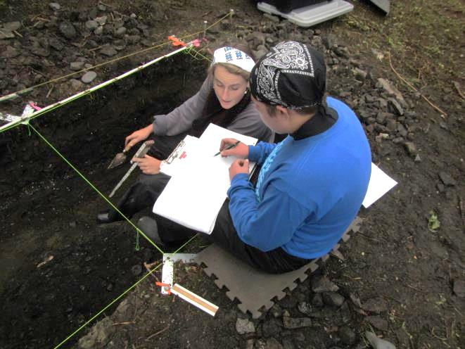
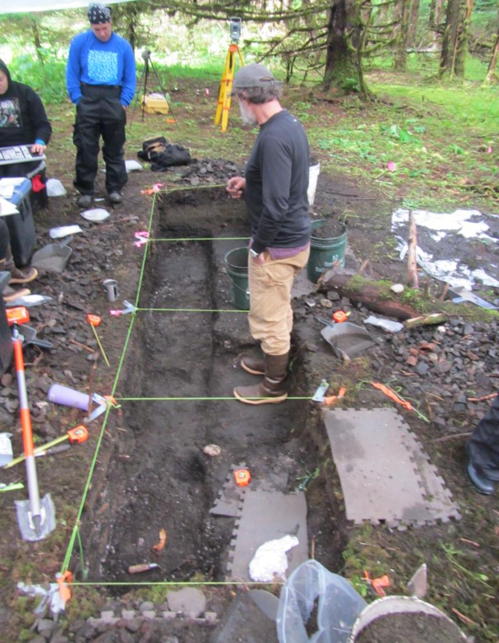
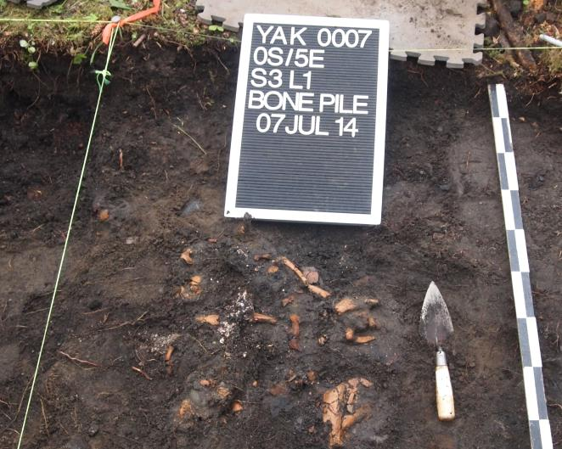
Excavating a midden test trench at the Tlákw.aan (Old Town) site, 2014

Slide 28
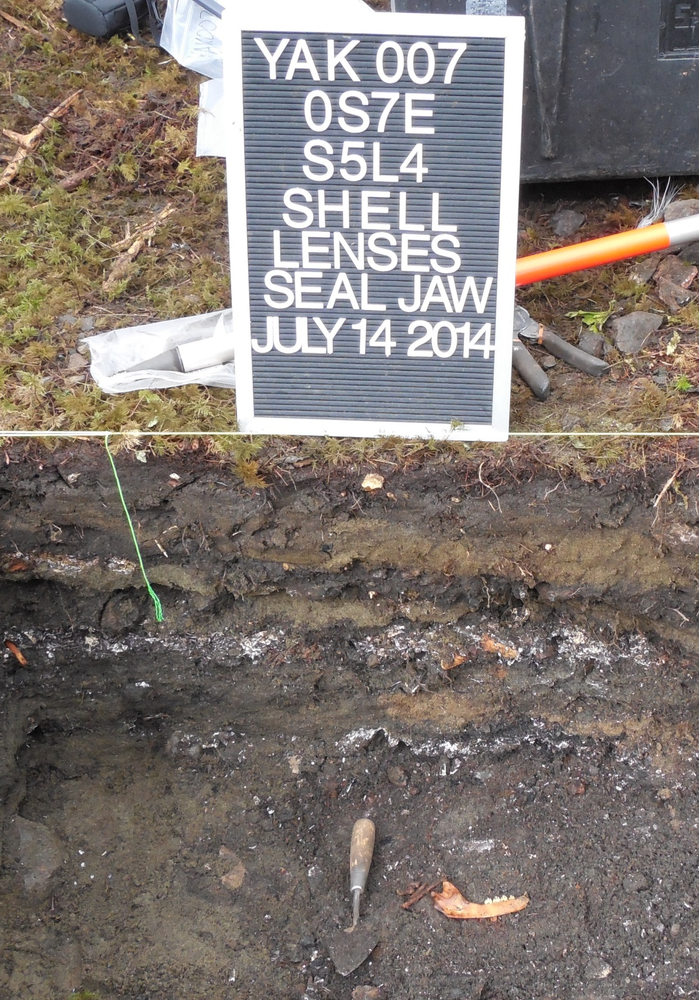
New data from the
Tlákw.aan midden:
Artifacts: for cultural infomation
Radiocarbon (C14) dating of charcoal:
the bottom of the site may be over 500
years old.
Identification of the animal bones:
revealing subsistence practices
Stable isotope analysis of shell:
to track changes in water temperature
Seal DNA: what areas of the Gulf
of Alaska did the seals migrate from?

Slide 29
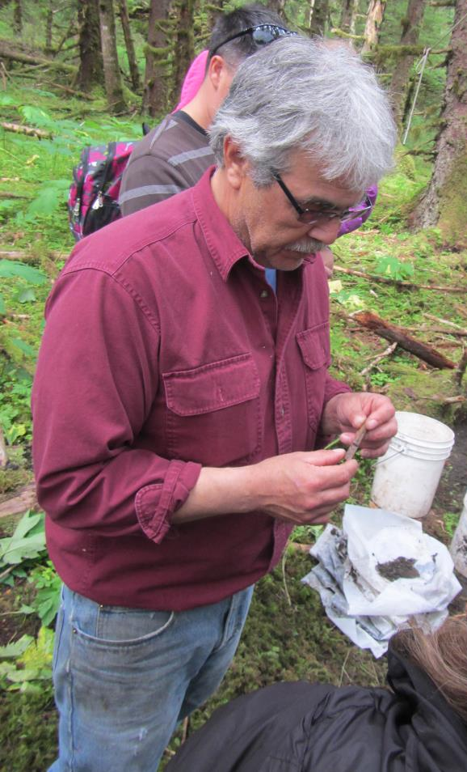
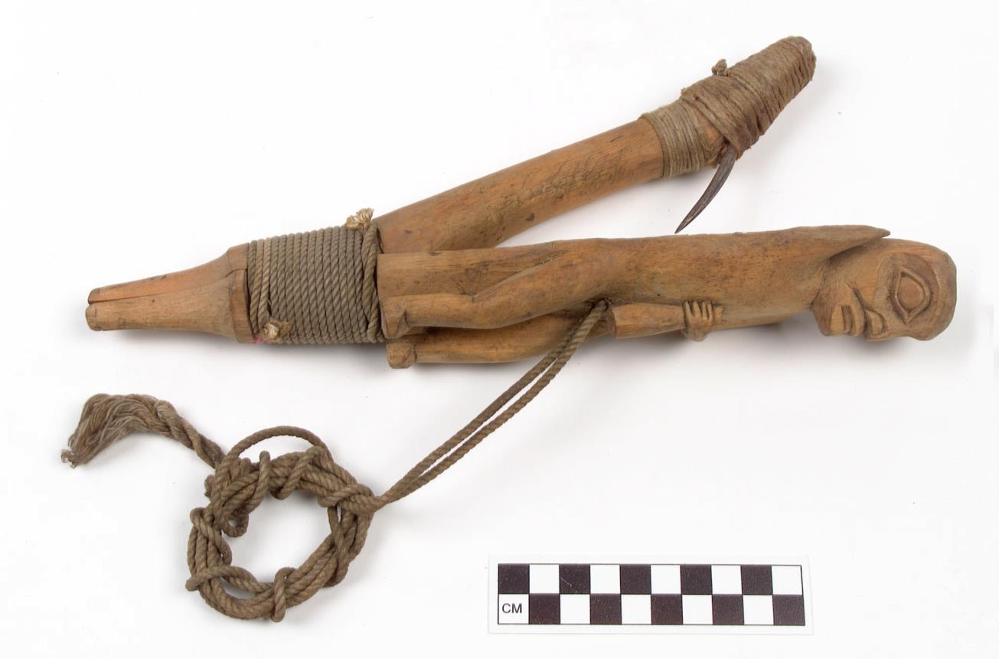
Fred Bemis identifying halibut hook
at the Old Town site
Bone barb for halibut hook

Slide 30
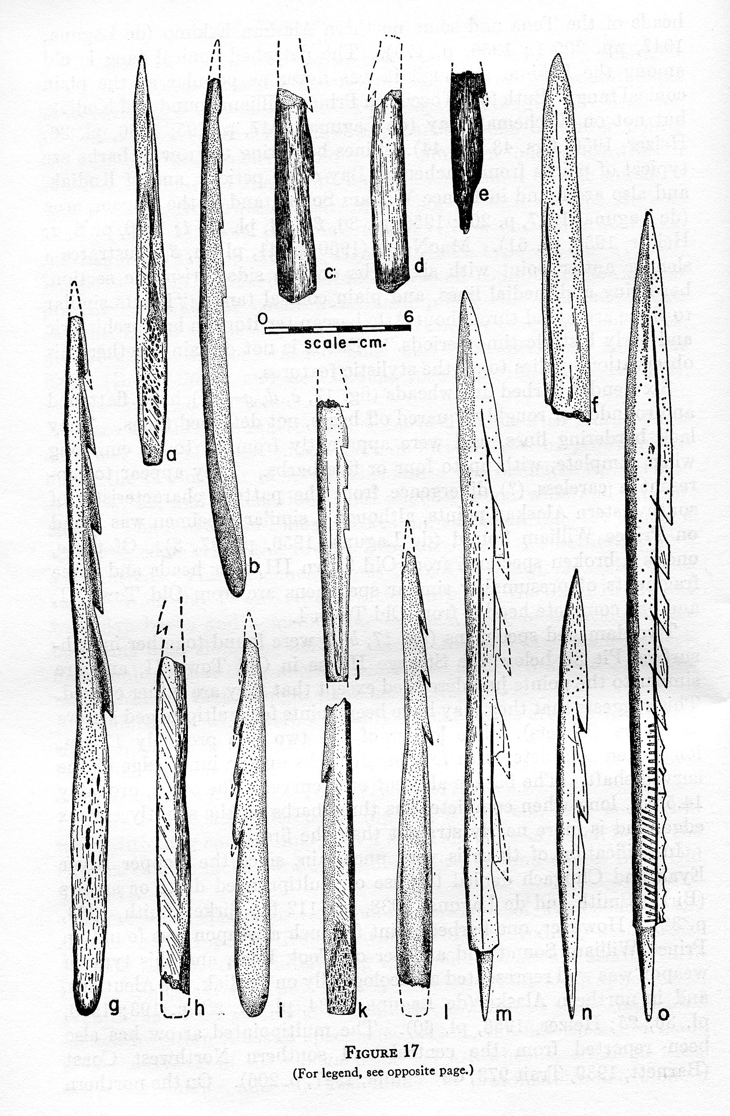
Barbed bone arrow point
found in 2014
Arrow points from Old Town (De Laguna et al. 1964)

Slide 31
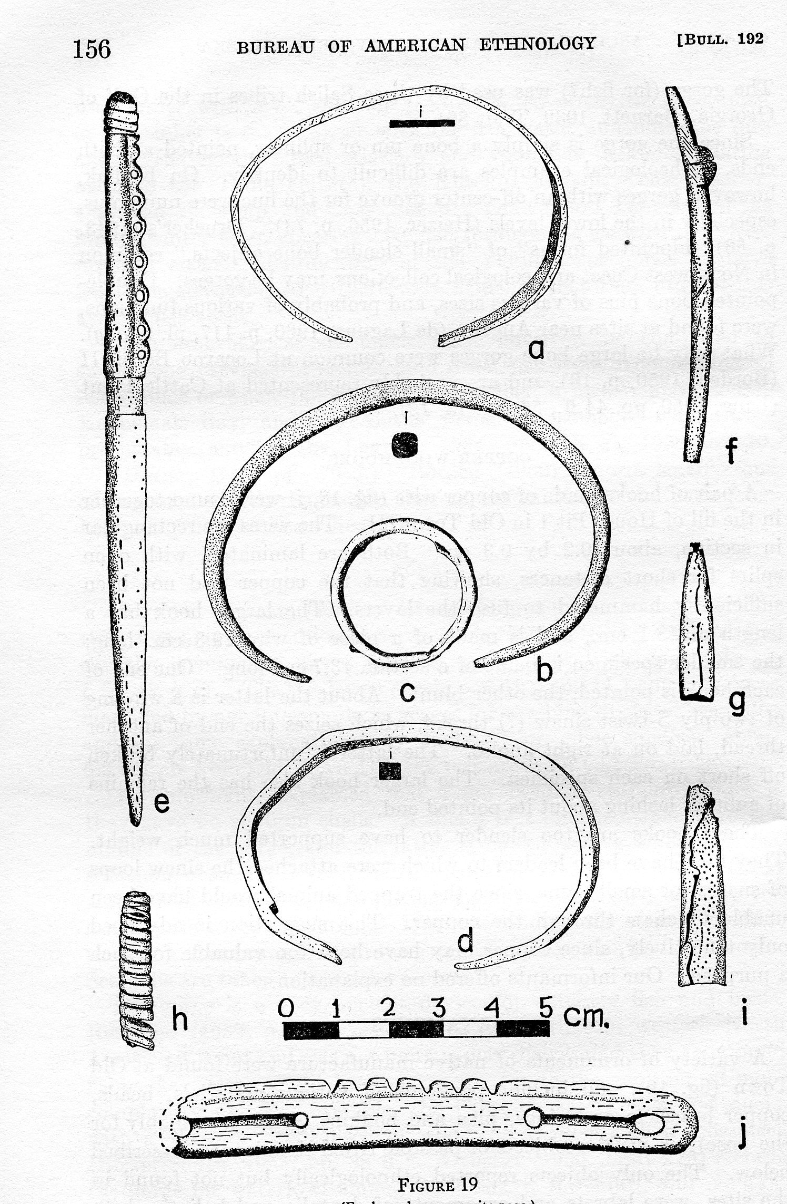
Decorative “tinkler cone” of
native copper found at the
Old Town site in 2014
Copper bracelets and cones (DeLaguna et al. 1964)

Slide 32
Seal harpooner at Yakutat, 1898-99
University of Washington Libraries Special Collections
Base of sealing harpoon
Head, Old Town site, 2014
Sealing harpoon head from Old Town (De Laguna et al. 1964)

Slide 33
Present
glacier
Qek’otliya
1890s AD
1791 AD
1400 AD
1410 AD
1275 AD
1550 AD
~1300 AD
~1130 AD
1218 AD
784 AD

Slide 34
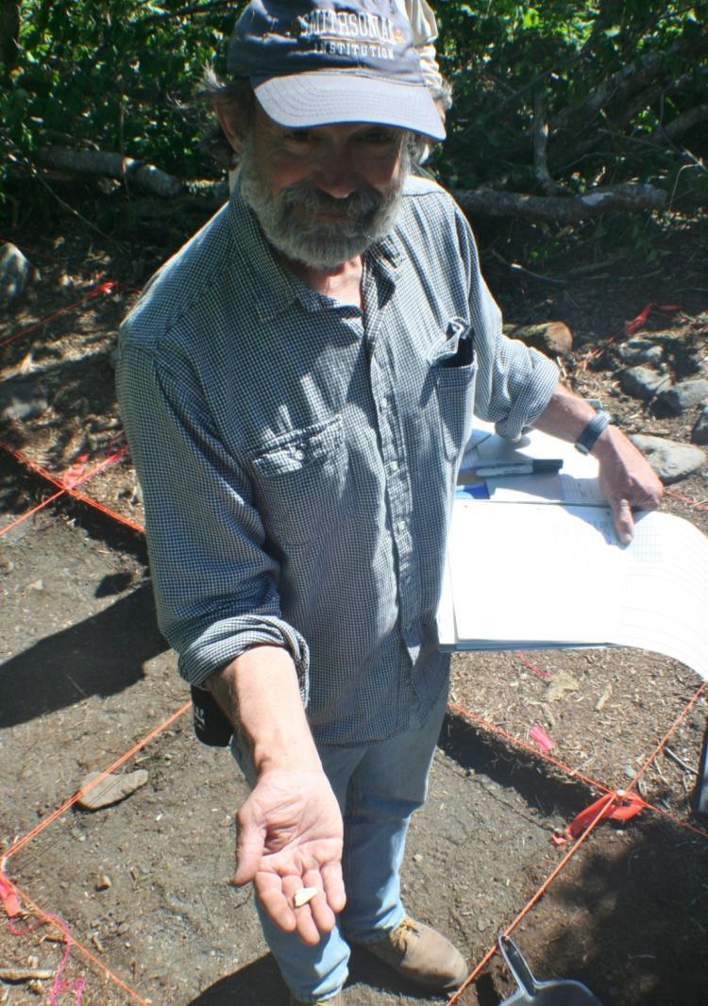
2013 field season
Excavations at Qek’otliya, an 1880s Tlingit seal hunting camp, 2013

Slide 36
Qek’otliya /Shaanáx Kuwóox’ sealing camp, Locality 1 on north side of Indian Camp Creek
Showing canvas tents and bark-covered smoke houses. Photographed on June 21, 1899.
Photos courtesy of the National Museum of the American Indian Archives.

Slide 37
Was the arrangement of lineage houses in the old Khantaak village (Shark House, Brown Bear House, Drum House, Moon House, Fort House, Wolf Den House) reproduced at the main Yakutat sealing camp?
Image of old Khantaak village (Sheppard, 1889)

Slide 38
Qek’otliya /Shaanáx Kuwóox’ sealing camp in June, 1899
YAK-00012 archaeological site
The location today, with surviving portion of camp indicated

Slide 39
Location of June 1899 camp, photos aligned with reference to ridge

Slide 40
Erosion
channel
Remains of camp
Old beach,
uplifted in 1899
Qek’otliya seal camp today, on uplifted terrace

Slide 41
Beach
Beach berm
Stream channel
Uplifted
terrace
Contour map of YAK-00012 archaeological site
(Qek’otliya /Shaanáx Kuwóox’ sealing camp)

Slide 42
Structure 1 rock outline after excavation; rocks used to hold
down the edges of the tent and to secure the guy lines.

Slide 43
Artifact scatters inside Structures 1 and 2, both completely excavated

Slide 44
Blue glass seed bead from Structure 1, YAK-00012 site

Slide 45
Henry .44 rifle center-fire rifle cartridge (1870s)

Slide 46
Community visit to the Qek’otliya /Shaanáx Kuwóox’ sealing camp site, 2013

Slide 47
Gunalchéesh
Tlingit Traditional Scholars
Yakutat Tlingit Tribe
Yak-Tat Kwaan, Inc.
Smithsonian Institution
University of Alaska
U. S Forest Service
National Park Service
Sealaska Heritage Institute
National Park Foundation
National Science Foundation

Slide 48
Present
glacier
1890s AD
1791 AD
1400 AD
1410 AD
1275 AD
1550 AD
~1300 AD
~1130 AD
1218 AD
784 AD

Slide 49
The Yakutat Sealing Camps Project:
900 Years of Hunting Tradition
Research Questions
Changes in the glaciers and environment over time
Locations and dates of the old sealing camps
Indigenous names (toponyms) and their meanings
Oral traditions, cultural values, social practices, and beliefs
Seal hunting methods and techniques
Everyday life and community in the sealing camps
Long-term relationship between people and seals in the Yakutat Bay ecosystem

