Slide 1
When life gives you lemons...
Yoram Bauman
standupeconomist.com

Slide 2
The classic
When life gives you lemons...
...make lemonade.

Slide 3

When life gives you lemons
You can go and build a lemonade stand
Sell it for a dollar fifty
Guaranteed to put a little cash in hand

Slide 4
But what about other variations?
For example, let’s compare getting an MBA with going to econ grad school.

Slide 5
MBA
When life gives you lemons...
...go corner the market for lemons.

Slide 6
Econ grad school
When life gives you lemons...
...go read “The Market for Lemons”.

Slide 7
Microeconomics
When life gives you lemons...
...consider a world with only two goods: lemons and “everything else”.
Show the budget constraint shifting so you can reach a higher indifference curve.
Extra credit: What if lemons are a bad rather than a good?

Slide 8
Macroeconomics
When life gives you lemons, show the macroeconomic impacts using an IS-LM model.
Extra credit: Come up with clever terminology that allows you to call it an “IS-LMn” model.

Slide 9
Milton Friedman
Permanent Lemon Hypothesis
When life gives you lemons, make lemonade, but don’t drink it all today.
Instead, drink a little bit more every day for the rest of your life.
Notes:
(inspired by Mandie Weinandt)

Slide 10
Development economics
When life gives you lemons...
...find 50 similar villages in Kenya.
Randomly divide them into two groups.
Give lemons to one group.
Wait 6 months.
Write a paper for the Journal of Development Economics.

Slide 11
The European Central Bank
When life gives you lemons...
...ask the Germans what to do.
Notes:
(from Evan)

Slide 12
Notes:
Gregory Petsko (“Feet in mouth disease,” Genome Biology, 2005)
But I have what appears to be the first documented proof!

Slide 13
Hyperinflation in Hell
Yoram Bauman, standupeconomist.com
Kurt Verkest, Pets Central Enterprises
JEL code: Z - Other Special Topics
Notes:
Our study, on the other hand, is highly empirical. You may wonder how we accomplish this; for now I will simply emphasize that my co-author is a veterinarian.

Slide 14
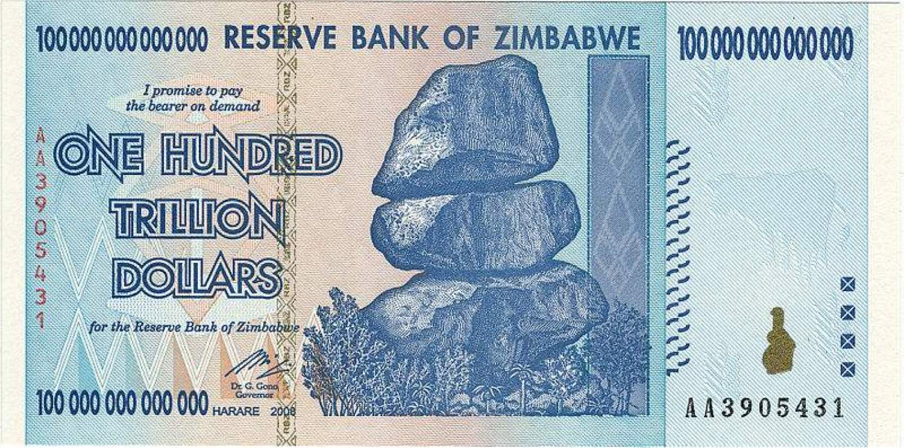
Hyperinflation on Earth

Slide 15
Hyperinflation in Hell
Conventional wisdom: economy of the afterworld is extremely stable.
We argue to the contrary:
Chronic hyperinflation...
...driven by massive increase in M4.
Notes:
(No evidence of central bankers in hell.)

Slide 16
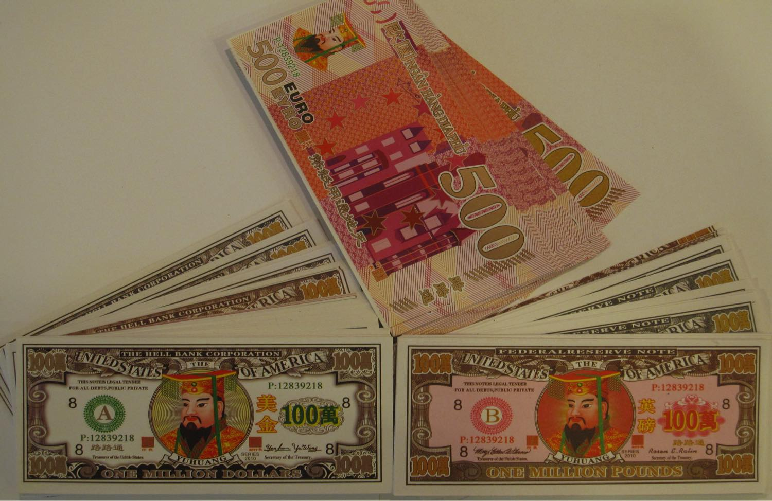
Joss paper
Notes:
Burned in China and elsewhere in Asia during funeral rites and certain holidays.
Goal is to supply decreased friends and relatives with money for goods and services.
Denominations up to $5 billion.
We focus on the effect of all this joss paper burning on money supply in the afterworld.
Theory, empirics, policy recommendations.

Slide 17
Theory
Everyone gets to be a central banker!
But this is not as great as it sounds
Tragedy of the Commons
Notes:
Powers that on Earth are limited to central bankers are therefore available to everybody.
In fact, marginal cost now equals zero (!) because of Hell Bank Note app.

Slide 18
Notes:
RatEx says that exchange rates must be equal: $1 = 1 GBP. (Why is the Euro so strong?)

Slide 19
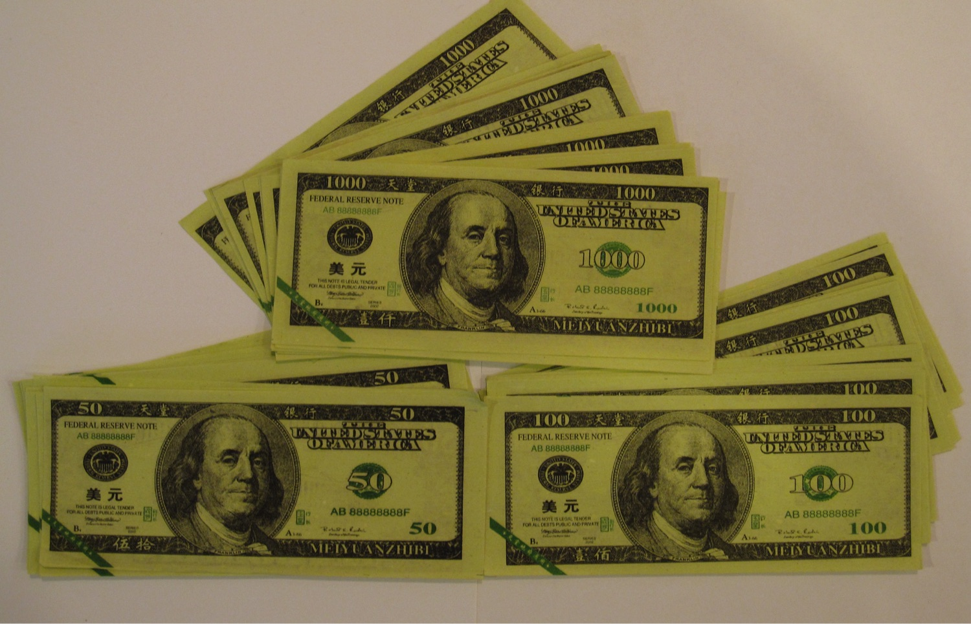

Slide 20
50x = 100x = 1000x
Proof: See mathematical appendix.
x = 0.

Slide 21
Necroeconomic reform
Level 1: The faithful should learn economics.
Level 2: The Fed and other central banks should take over the underworld.
Level 3: Dollarization.
Notes:
Unfortunately, education by itself is unlikely to solve the Tragedy of the Commons, so this may not be sufficient.
Expanding their already-swollen balance sheets to include the afterworld should be easy.
Such “dollarization” is likely to prove as successful in the afterworld as it has been here on Earth.

Slide 22
Epilogue
Submitted Dec 2012 to Economic Inquiry.
Ref #1: It is funny (as long as you are constrained to reading economics articles).
Ref #2: It is entertaining in the sense that a stand-up comedy routine is entertaining.
Editorial decision: Rejection.
Notes:
Gregory Petsko (“Feet in mouth disease,” Genome Biology, 2005)
But I have what appears to be the first documented proof!

Slide 23
Referee concerns
The paper lacks a Dynamic Postmortem General Equilibrium model (DPGE).
The paper makes the mistaken assumption that there is no technological progress in the afterlife. Why would the dead suddenly lose their capacity to innovate?
Notes:
Gregory Petsko (“Feet in mouth disease,” Genome Biology, 2005)
But I have what appears to be the first documented proof!

Slide 24
Referee concerns
The paper lacks a Dynamic Postmortem General Equilibrium model (DPGE).
The paper makes the mistaken assumption that there is no technological progress in the afterlife. Why would the dead suddenly lose their capacity to innovate?
PS. Where is the promised mathematical appendix?
Notes:
Gregory Petsko (“Feet in mouth disease,” Genome Biology, 2005)
But I have what appears to be the first documented proof!

Slide 25
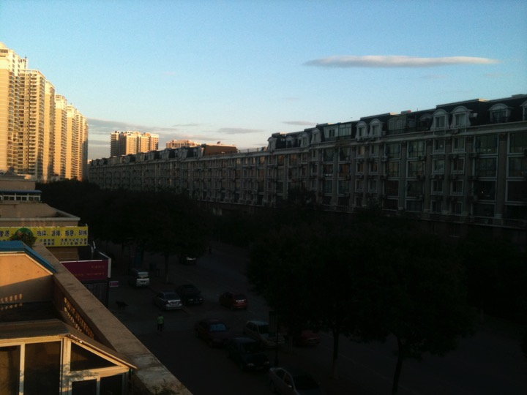

Slide 26
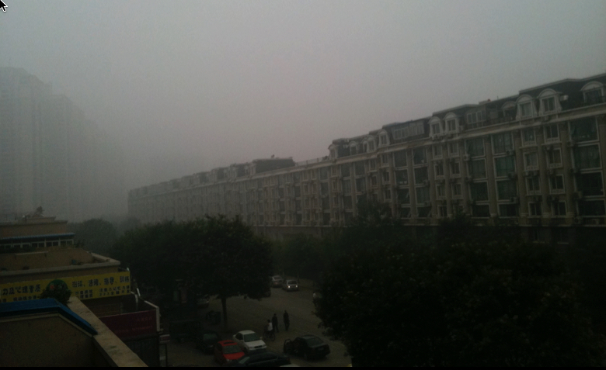

Slide 27
Mankiw’s Ten Principles of Economics, Translated
Yoram Bauman, PhD
Notes:
Appear before you as the world’s first and only stand-up economist. (Low entertainment budget.)
Only a couple things going for me: make fun of macroeconomists. Low expectations.
That’s not a lot to have going for me, and in fact it’s been tough being a stand-up economist.
Dad says I’m crazy – No demand. Supply side, trickle down, Laffer curve.
Translate plain English into incomprehensible gibberish. But in grad school I had the opposite ability: to translate economic gibberish into plain English.
And that’s what I’m here to speak to you about today.

Slide 28
The 10 Principles of Economics
People face tradeoffs
The cost of something is what you give up to get it
Rational people think at the margin
People respond to incentives
Trade can make everyone better off
Markets are usually a good way to organize economic activity
Gvmts can sometimes improve market outcomes
A country's standard of living depends on its ability to produce goods and services
Prices rise when the government prints too much money
Society faces a short-run tradeoff between inflation and unemployment
Notes:
Practically need a PhD to understand them. Fortunately, I happen to have one.
Divide into micro and macro: microeconomists are wrong about specific things, macroeconomists are wrong about things in general.
Let’s start with macro principles 8, 9, 10: these all have the same translation…

Slide 29
The 10 Principles of Economics
People face tradeoffs
The cost of something is what you give up to get it
Rational people think at the margin
People respond to incentives
Trade can make everyone better off
Markets are usually a good way to organize economic activity
Gvmts can sometimes improve market outcomes
Blah blah blah
Blah blah blah
Blah blah blah
Notes:
You know how you can tell we’re making progress? We can use a bigger font! …

Slide 30
The 10 Principles of Economics
People face tradeoffs
The cost of something is what you give up to get it
Rational people think at the margin
People respond to incentives
Trade can make everyone better off
Markets are usually a good way to organize economic activity
Governments can sometimes improve market outcomes
Blah blah blah
Blah blah blah
Blah blah blah
Notes:
As Einstein might have put it, everything should be as simple as possible, if not simpler.
OK, back to microeconomics. Principle #1 has an easy translation…

Slide 31
The 10 Principles of Economics
People face tradeoffs
Choices are bad
The cost of something is what you give up to get it
Rational people think at the margin
People respond to incentives
Trade can make everyone better off
Markets are usually a good way to organize economic activity
Governments can sometimes improve market outcomes
Blah blah blah
Blah blah blah
Blah blah blah
Notes:
This is a simple syllogism. Tradeoffs are bad, and whenever you have choices you have tradeoffs. Therefore, choices are bad. If anybody doesn’t understand that, there’s a clarification in Principle #2, which has the translation…

Slide 32
The 10 Principles of Economics
People face tradeoffs
Choices are bad
The cost of something is what you give up to get it
Choices are really bad
Rational people think at the margin
People respond to incentives
Trade can make everyone better off
Markets are usually a good way to organize economic activity
Governments can sometimes improve market outcomes
Blah blah blah
Blah blah blah
Blah blah blah
Notes:
Proof: Snickers bar is valued at $1, if someone offers it to you, you have the choice of the Snickers bar ($1) or nothing ($0), so your “economic profit” is $1. Now imagine that someone offers you a choice between a Snickers bar ($1) and some M&Ms ($0.70). Now your economic profit is only $0.30! In fact, the worst possible situation would be someone offering you a choice between two identical Snickers bars. People who don’t understand economics would say that that’s the same as being offered one Snickers bar, but that kind of thinking will NEVER get you a tenure-track position. Economists know that being offered a choice between 2 identical Snickers bars is the same as being offered nothing at all. Anyone who doesn’t understand that is stupid.
Okay, let’s see where that gets us…

Slide 33
The 10 Principles of Economics
Choices are bad
Choices are really bad
Rational people think at the margin
People respond to incentives
Trade can make everyone better off
Markets are usually a good way to organize economic activity
Governments can sometimes improve market outcomes
Blah blah blah
Blah blah blah
Blah blah blah
Notes:
You may think I was a bit harsh in saying that people who don’t understand why choices are bad are stupid. But just look at the next principle of economics. Translation: People are stupid.

Slide 34
The 10 Principles of Economics
Choices are bad
Choices are really bad
Rational people think at the margin
People are stupid
4. People respond to incentives
5. Trade can make everyone better off
Markets are usually a good way to organize economic activity
Governments can sometimes improve market outcomes
Blah blah blah
Blah blah blah
Blah blah blah
incentive, n. Synonym: See motive.
Notes:
It is immediately obvious to the most casual observer with the meanest intelligence that most people do not think at the margin. Nobody goes to the grocery store and says “I’m going to buy an orange. I’m going to buy another orange. I’m going to buy another orange.” But if, as Mankiw says, rational people think at the margin, and if—as we all know—most people do not think at the margin, we are let to a most unhappy conclusion: most people are not rational, i.e., most people are stupid.
But don’t despair; just take a look at the next principle, “People respond to incentives”
Now, let’s look at the dictionary definition. What Mankiw is saying here is that people are motivated by motives, or that people are influenced to action by things that influence to action. Now, this may seem to be a bit like saying that tautologies are tautological---you might think that people would have to be pretty stupid to be unmotivated by motives, or to be inactive in response to something that influences to action. But remember: People \emph{are} stupid. (Remember all those people with their hands up?) Hence the need to clarify that people aren't \emph{that} stupid.
Okay, where does that leave us?

Slide 35
The 10 Principles of Economics
Choices are bad
Choices are really bad
Rational people think at the margin
People are stupid
4. People respond to incentives
People aren’t
5. Trade can make everyone better off
Markets are usually a good way to organize economic activity
Governments can sometimes improve market outcomes
Blah blah blah
Blah blah blah
Blah blah blah
that stupid
Notes:
OK, let’s consolidate our intellectual gains.

Slide 36
The 10 Principles of Economics
Choices are bad
Choices are really bad
People are stupid
People aren’t that stupid
Trade can make everyone better off
Markets are usually a good way to organize economic activity
Governments can sometimes improve market outcomes
Blah blah blah
Blah blah blah
Blah blah blah
Notes:
We could almost go up one more font size!

Slide 37
The 10 Principles of Economics
Choices are bad
Choices are really bad
People are stupid
People aren’t that stupid
Trade can make everyone better off
Trade can make
Markets are usually a good way to organize economic activity
Governments can sometimes improve market outcomes
Blah blah blah
Blah blah blah
Blah blah blah
everyone worse off
Notes:
How can this mean the opposite of what it says?

Slide 38
The 10 Principles of Economics
Trade can make everyone better off
Trade can make everyone worse off
⇧
#1: Trade can make everyone better off.
#2: Trade will make everyone better off.
Notes:
How can this mean the opposite of what it says?

Slide 39
The 10 Principles of Economics
Trade can make everyone better off
Trade can make everyone worse off
⇧
#1: Trade can make everyone better off.
#2: Trade will make everyone better off.
Notes:
How can this mean the opposite of what it says?

Slide 40
The 10 Principles of Economics
Trade can make everyone better off
Trade can make everyone worse off
⇧
#1: Trade can make everyone better off.
#2: Trade will make everyone better off.
►Trade can make some people worse off!!!!
§
►Trade can make everyone worse off!!!!!!!
§ Consider a small town with three families: Family #1 wants a snowblower, Family #2 wants a leafblower, and Family #3 wants a lawnmower; each family values their particular need at $200. It also just so happens that Family #1 owns a leafblower, Family #2 owns a lawnmower, and Family #3 owns a snowblower. These sit unused in their respective garages; each family has no use for its current equipment, and therefore values it at $0. The situation appears ripe for gains from trade! Unfortunately, life in this small town is not so simple: the town is located in a valley that is susceptible to severe air pollution problems. Blowers and mowers emit so much pollution that use of any one piece of equipment will increase hospital bills (for asthma &etc) by $80 for each family. Three additional blowers and mowers will therefore increase each family's bills by $240. Result #1: All three trades will still take place. For example, if Family #3 sells Family #1 its snowblower for $100 then each family gains $100 from the trade, minus $80 in hospital bills, for a net gain of $20. Result #2: The three trades together make everyone worse off: if each family sells its unused equipment for $100 and buys its desired equipment for $100 then each family gains $200 from its trades. But each family lose $240 in hospital bills, for a net loss of $40. Conclusion: Trade can make everyone worse off!
Notes:
How can this mean the opposite of what it says?

Slide 41
The 10 Principles of Economics
Choices are bad
Choices are really bad
People are stupid
People aren’t that stupid
Trade can make everyone better off
Trade can make
Markets are usually a good way to organize economic activity
Governments can sometimes improve market outcomes
Blah blah blah
Blah blah blah
Blah blah blah
everyone worse off
Notes:
Only two principles left, and what I want you to see is that they follow directly from principle #5 and its translation…

Slide 42
The 10 Principles of Economics
Choices are bad
Choices are really bad
People are stupid
People aren’t that stupid
Trade can make everyone better off
Trade can make
Markets are usually a good way to organize economic activity
Governments are stupid
7. Governments can sometimes improve market outcomes
Blah blah blah
Blah blah blah
Blah blah blah
everyone worse off
Notes:
If trade can make everyone better off, what do we need government for?
If trade can make everyone worse off, we better have a government around to stop people from trading!
Now… remember where we started?...

Slide 43
The 10 Principles of Economics
Choices are bad
Choices are really bad
People are stupid
People aren’t that stupid
Trade can make everyone better off
Trade can make
Markets are usually a good way to organize economic activity
Governments are stupid
Governments can sometimes improve market outcomes
Governments aren’t
Blah blah blah
Blah blah blah
Blah blah blah
that stupid
everyone worse off
Notes:
If trade can make everyone better off, what do we need government for?
If trade can make everyone worse off, we better have a government around to stop people from trading!
Now… remember where we started?...

Slide 44
The 10 Principles of Economics
Translated
Choices are bad
Choices are really bad
People are stupid
People aren’t that stupid
Trade can make
Governments are stupid
Governments aren’t
Blah blah blah
Blah blah blah
Blah blah blah
that stupid
everyone worse off
www.standupeconomist.com
Notes:
If trade can make everyone better off, what do we need government for?
If trade can make everyone worse off, we better have a government around to stop people from trading!
Now… remember where we started?...

Slide 45
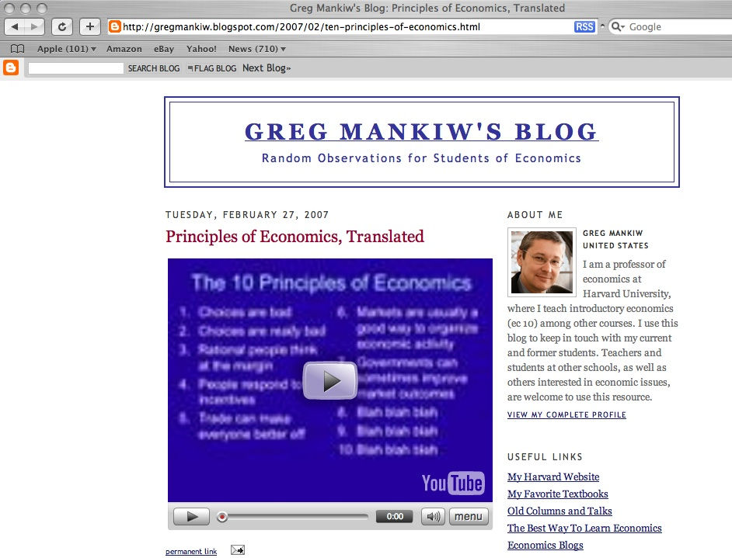
1,000,000+ YouTube views

Slide 46
Favorite YouTube comments
[coolway]: “I can't tell whether this is supposed to be funny or educational.”
[treeohtwo]: “You’re funny (and I don't say that to a lot of people. Lots of people are not funny. Lots of people are sad.)”
[bootsielon]: “A Jew who’s an economist and a stand-up comedian? You can’t get any more stereotypical than that!”
Notes:
Chasna2 has no sense of humor. The video is funny because it shows how Keynesian economic thinking is totally twisted. The only theoretical economic framework that actually functions in the real world is the Austrian/Misean school of thought. Do a search for Ludwig von Mises (Mee-zis). You can learn more about how economics actually works from reading ten pages of his stuff than you can from ten years of economics courses.
woo, this is my professor! –hybird21
abnormally insightful –uclagkh
the sad thing is that i spaced off listening to this, not to mention my own real economics class –threecrowns

Slide 47
Favorite YouTube comments
[tangshanjige]: “the man in the vedio is the most stupid man in the world.”
[ThreeCrowns]: “I spaced off listening to this, [just like in my] real economics class.”
[RenegadeMystic]: “They make economics boring and confusing unpurpose because they don't want you to figure out that the whole economy is a ponzi scheme.”
Notes:
[Tharenii]: “i love you man! I AM STUDYING FOR MY ECONOMICS TEST which is in 15 hours.”
[freekyboi123]: “this is the gayest s*** i have ever seen.”
Treeohtwo: You’re funny (and I don't say that to a lot of people. Lots of people are not funny. Lots of people are sad.)
:
Grazie55555: Thanks for keeping us updated. Let us know when you eventually drop out altogether and devote your life to smoking crack and getting banged by seedy old men for change.
P717: Good stuff. You could never get away with that here in the south, however. You'd be over people's heads. Seeing New Yorkers clap at your sets puts just a little of my faith in human intelligence back.
Martin1917: if you believe what you wrote, then you just proved my point. And no, I have a PhD in economics. But I still find this boring. It is because economists are boring as a rule, except for those involved in evolutionary, non-equilibrium economics and economic history. Say Schumpeter, Kaldor or Myrdal.

Slide 48
Favorite YouTube comments
[1tonykirk]: “What a confusion of deceptions... The U.S. Congress does not print money as the Constitution dictates. That power was usurped by a Cabal of International Banksters in 1913.”
“The Federal Reserve is about as federal as Federal Express.”
Notes:
Chasna2 has no sense of humor. The video is funny because it shows how Keynesian economic thinking is totally twisted. The only theoretical economic framework that actually functions in the real world is the Austrian/Misean school of thought. Do a search for Ludwig von Mises (Mee-zis). You can learn more about how economics actually works from reading ten pages of his stuff than you can from ten years of economics courses.
woo, this is my professor! –hybird21
abnormally insightful –uclagkh

Slide 49
Favorite YouTube comments
[Surhot]: “In defense of the Fed… if we got rid of it, we'd still need to replace it with something that does its functions: i.e., printing money [and] clearing checks.”
[wwendt1]: The Fed does not print money, [but] it does control the money supply overall thru its ability to expand and contract bank reserves.
[Surhot]: “Oh, yeah, that's right. Thanks.”
Notes:
Chasna2 has no sense of humor. The video is funny because it shows how Keynesian economic thinking is totally twisted. The only theoretical economic framework that actually functions in the real world is the Austrian/Misean school of thought. Do a search for Ludwig von Mises (Mee-zis). You can learn more about how economics actually works from reading ten pages of his stuff than you can from ten years of economics courses.
woo, this is my professor! –hybird21
abnormally insightful –uclagkh

Slide 50
Favorite YouTube comments
[jonnybravo8]: “Translate?”
[monikerjak]: “He's poking fun at micro.”
[jonnybravo8]: “yeah, but translate, you jerk!”
[monikerjak]: “That was a translation… you should probably stick to entertaining yourself with less intellectually demanding material.”
Notes:
[monikerjak]: “…It's looking at [economic principles] from a hilariously ridiculous yet not exactly untrue perspective. If you don't understand the humor then you are simply ignorant to the fundamentals of economics and judging by your demeanor you're probably some high school dropout loser, you should probably stick to entertaining yourself through less intellectually demanding material.”
Treeohtwo: You’re funny (and I don't say that to a lot of people. Lots of people are not funny. Lots of people are sad.)
Jtfowler418: This guy rules. BTW, I am not an economist, I switched my major.
Grazie55555: Thanks for keeping us updated. Let us know when you eventually drop out altogether and devote your life to smoking crack and getting banged by seedy old men for change.
P717: Good stuff. You could never get away with that here in the south, however. You'd be over people's heads. Seeing New Yorkers clap at your sets puts just a little of my faith in human intelligence back.
Martin1917: if you believe what you wrote, then you just proved my point. And no, I have a PhD in economics. But I still find this boring. It is because economists are boring as a rule, except for those involved in evolutionary, non-equilibrium economics and economic history. Say Schumpeter, Kaldor or Myrdal.

Slide 51
Favorite YouTube comments
[jtfowler418]: “This [video] rules. By the way, I am not an economist, I switched my major.”
[grazie55555]: “Thanks for keeping us updated. Let us know when you drop out altogether and devote your life to smoking crack…”
Notes:
Treeohtwo: You’re funny (and I don't say that to a lot of people. Lots of people are not funny. Lots of people are sad.)
:
Grazie55555: Thanks for keeping us updated. Let us know when you eventually drop out altogether and devote your life to smoking crack and getting banged by seedy old men for change.
P717: Good stuff. You could never get away with that here in the south, however. You'd be over people's heads. Seeing New Yorkers clap at your sets puts just a little of my faith in human intelligence back.
Martin1917: if you believe what you wrote, then you just proved my point. And no, I have a PhD in economics. But I still find this boring. It is because economists are boring as a rule, except for those involved in evolutionary, non-equilibrium economics and economic history. Say Schumpeter, Kaldor or Myrdal.

Slide 52
The 10 Principles of Economics
Trade can make everyone better off
Trade can make everyone worse off
⇧
#1: Trade can make everyone better off.
#2: Trade will make everyone better off.
►Trade can make some people worse off!!!!
§
►Trade can make everyone worse off!!!!!!!
§ Consider a small town with three families: Family #1 wants a snowblower, Family #2 wants a leafblower, and Family #3 wants a lawnmower; each family values their particular need at $200. It also just so happens that Family #1 owns a leafblower, Family #2 owns a lawnmower, and Family #3 owns a snowblower. These sit unused in their respective garages; each family has no use for its current equipment, and therefore values it at $0. The situation appears ripe for gains from trade! Unfortunately, life in this small town is not so simple: the town is located in a valley that is susceptible to severe air pollution problems. Blowers and mowers emit so much pollution that use of any one piece of equipment will increase hospital bills (for asthma &etc) by $80 for each family. Three additional blowers and mowers will therefore increase each family's bills by $240. Result #1: All three trades will still take place. For example, if Family #3 sells Family #1 its snowblower for $100 then each family gains $100 from the trade, minus $80 in hospital bills, for a net gain of $20. Result #2: The three trades together make everyone worse off: if each family sells its unused equipment for $100 and buys its desired equipment for $100 then each family gains $200 from its trades. But each family lose $240 in hospital bills, for a net loss of $40. Conclusion: Trade can make everyone worse off!
Notes:
How can this mean the opposite of what it says?

Slide 53



Trade can make everyone worse off
Orange, Pink, and Blue live in a small town with an air pollution problem.

Slide 54
Trade can make everyone worse off
Orange, Pink, and Blue live in a small town with an air pollution problem. They also each have a garage full of gadgets they currently don’t use.

Slide 55
Trade can make everyone worse off
+100
- 80
+100
- 80
- 80
Orange sells a lawnmower to Pink.
Notes:
Okay, back to the jokes.

Slide 56
Trade can make everyone worse off
+100
- 80
+100
- 80
- 80
- 80
+100
- 80
+100
- 80
Orange sells a lawnmower to Pink.
Pink sells a motorcycle to Blue.
Notes:
Okay, back to the jokes.

Slide 57
Trade can make everyone worse off
+100
- 80
+100
- 80
- 80
- 80
+100
- 80
+100
- 80
+100
- 80
- 80
+100
- 80
Orange sells a lawnmower to Pink.
Pink sells a motorcycle to Blue.
Blue sells a chainsaw to Orange.
Notes:
Okay, back to the jokes.

Slide 58
Trade can make everyone worse off
- 40
- 40
- 40
China
EU/Japan
USA/Can
Notes:
Okay, back to the jokes.

Slide 59
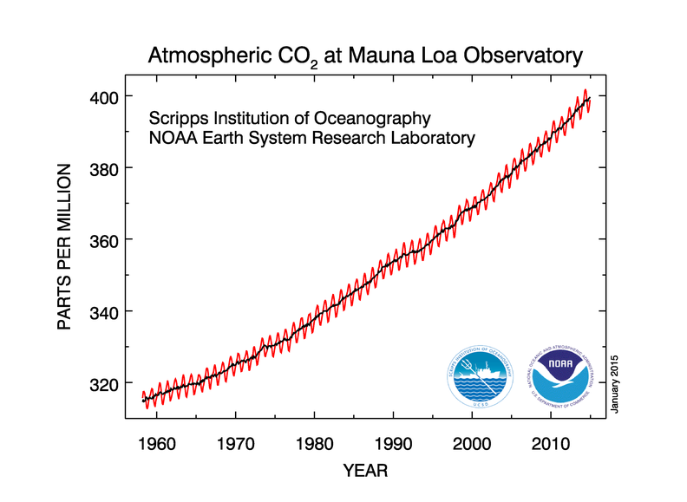
Carbon concentrations going up
Source: : http://www.esrl.noaa.gov/gmd/ccgg/trends/

Slide 60
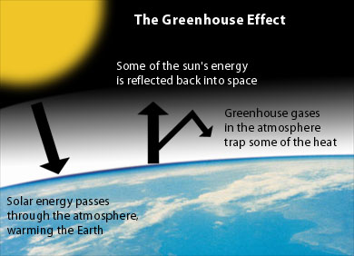
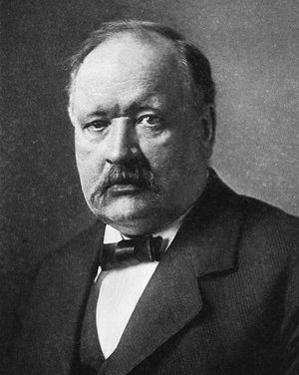
Arrhenius (Swedish chemist), 1896
Notes:
http://www.environmentalsociety.ca/issues/climate/images/greenhouse-effect.jpg
http://en.wikipedia.org/wiki/Svante_Arrhenius

Slide 61
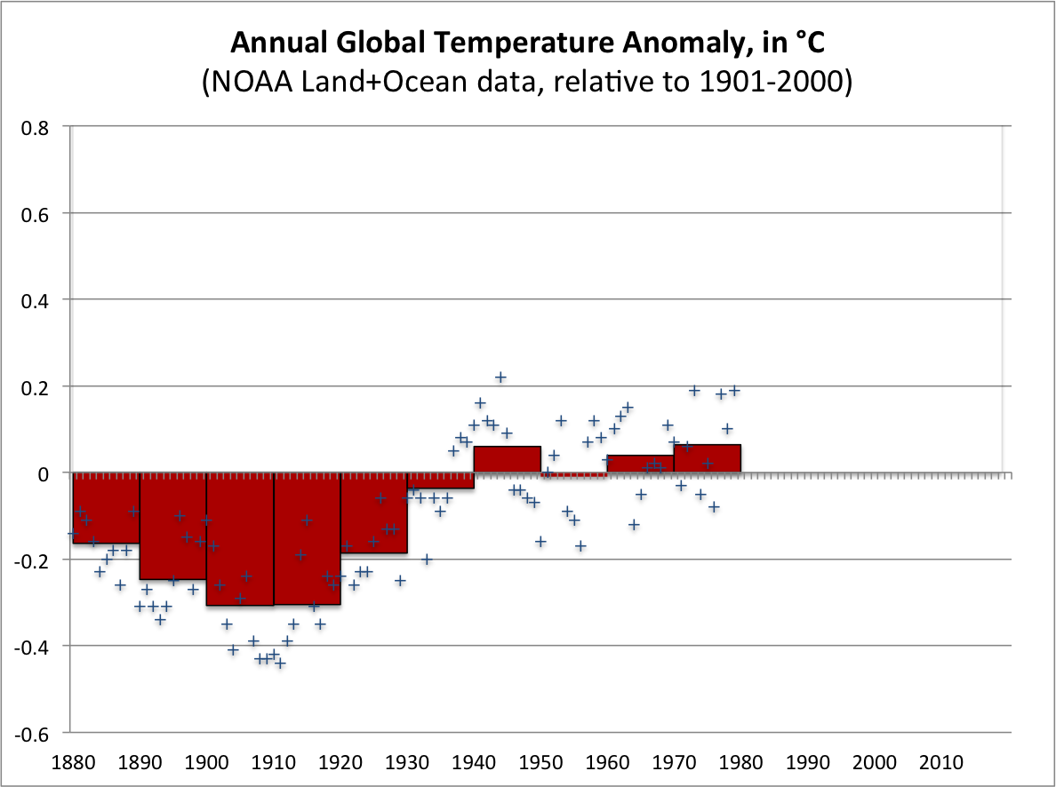
Notes:
ftp://ftp.ncdc.noaa.gov/pub/data/anomalies/monthly.land_ocean.90S.90N.df_1901-2000mean.dat
http://www.ncdc.noaa.gov/img/climate/research/2009/decadal-global-temps-1880s-2000s.gif
http://www.ncdc.noaa.gov/sotc/?report=global

Slide 62
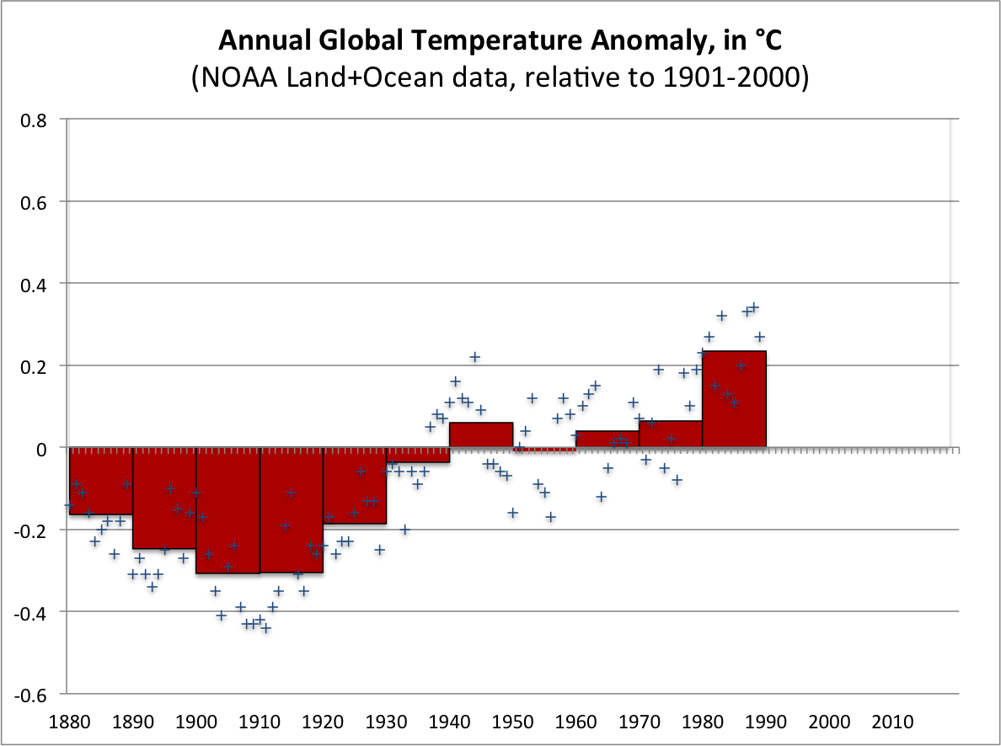
Notes:
ftp://ftp.ncdc.noaa.gov/pub/data/anomalies/monthly.land_ocean.90S.90N.df_1901-2000mean.dat
http://www.ncdc.noaa.gov/img/climate/research/2009/decadal-global-temps-1880s-2000s.gif
http://www.ncdc.noaa.gov/sotc/?report=global

Slide 63
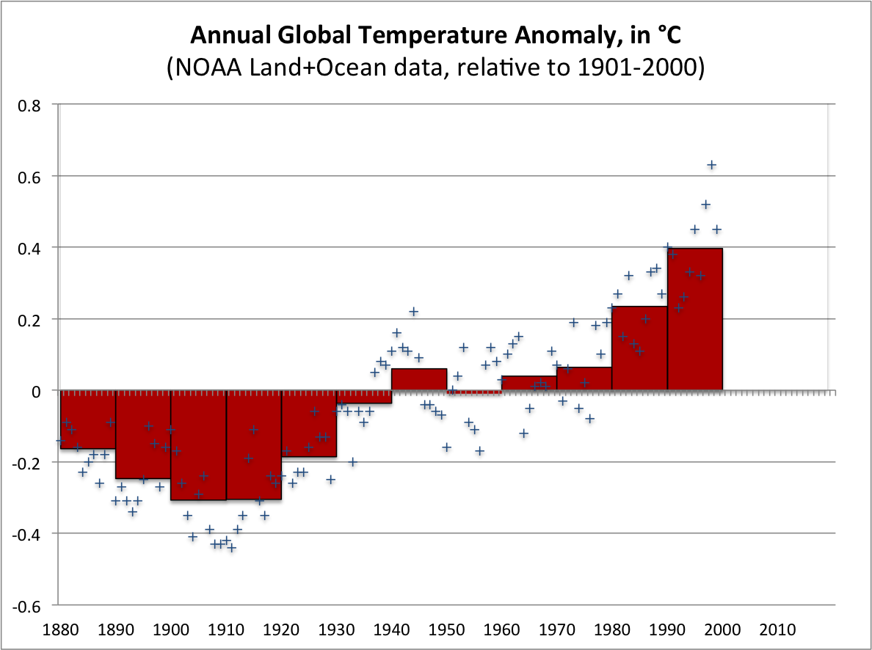
Notes:
ftp://ftp.ncdc.noaa.gov/pub/data/anomalies/monthly.land_ocean.90S.90N.df_1901-2000mean.dat
http://www.ncdc.noaa.gov/img/climate/research/2009/decadal-global-temps-1880s-2000s.gif
http://www.ncdc.noaa.gov/sotc/?report=global

Slide 64
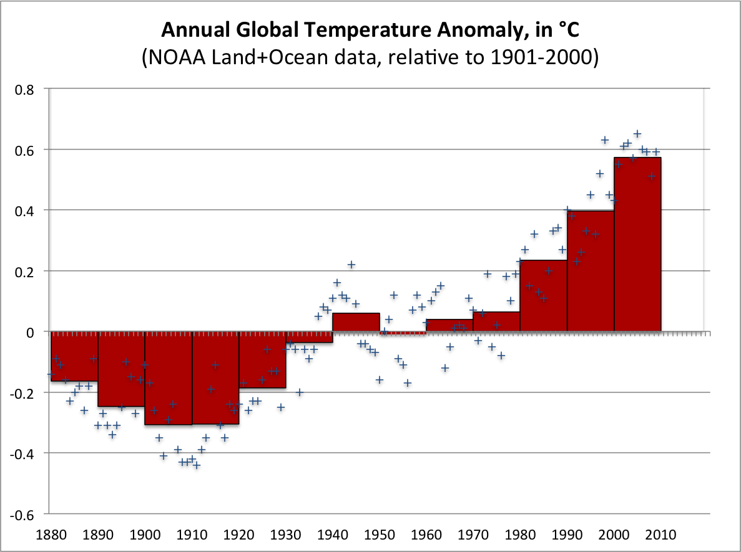
Notes:
ftp://ftp.ncdc.noaa.gov/pub/data/anomalies/monthly.land_ocean.90S.90N.df_1901-2000mean.dat
http://www.ncdc.noaa.gov/img/climate/research/2009/decadal-global-temps-1880s-2000s.gif
http://www.ncdc.noaa.gov/sotc/?report=global

Slide 65
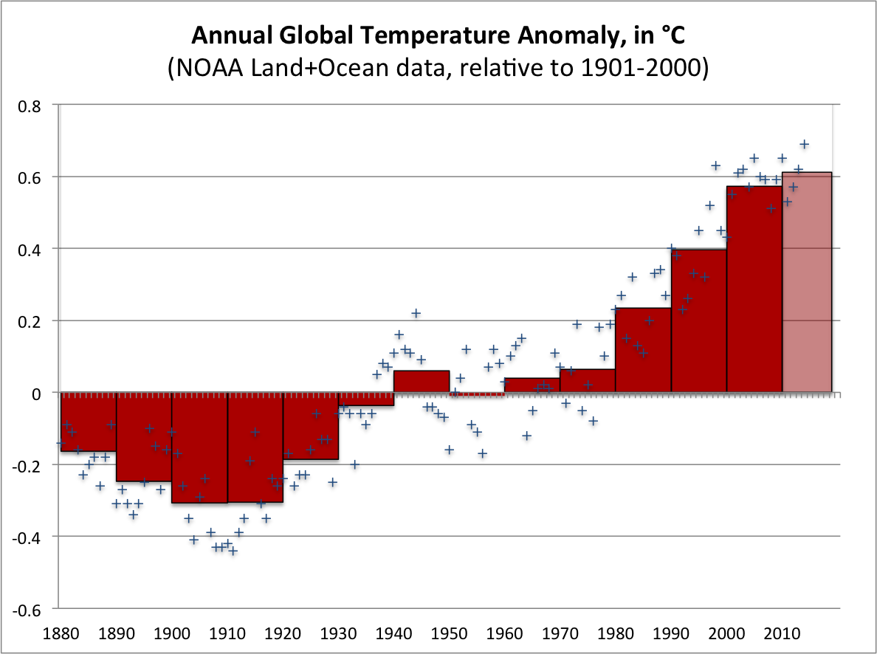
Notes:
ftp://ftp.ncdc.noaa.gov/pub/data/anomalies/monthly.land_ocean.90S.90N.df_1901-2000mean.dat
http://www.ncdc.noaa.gov/img/climate/research/2009/decadal-global-temps-1880s-2000s.gif
http://www.ncdc.noaa.gov/sotc/?report=global

Slide 66
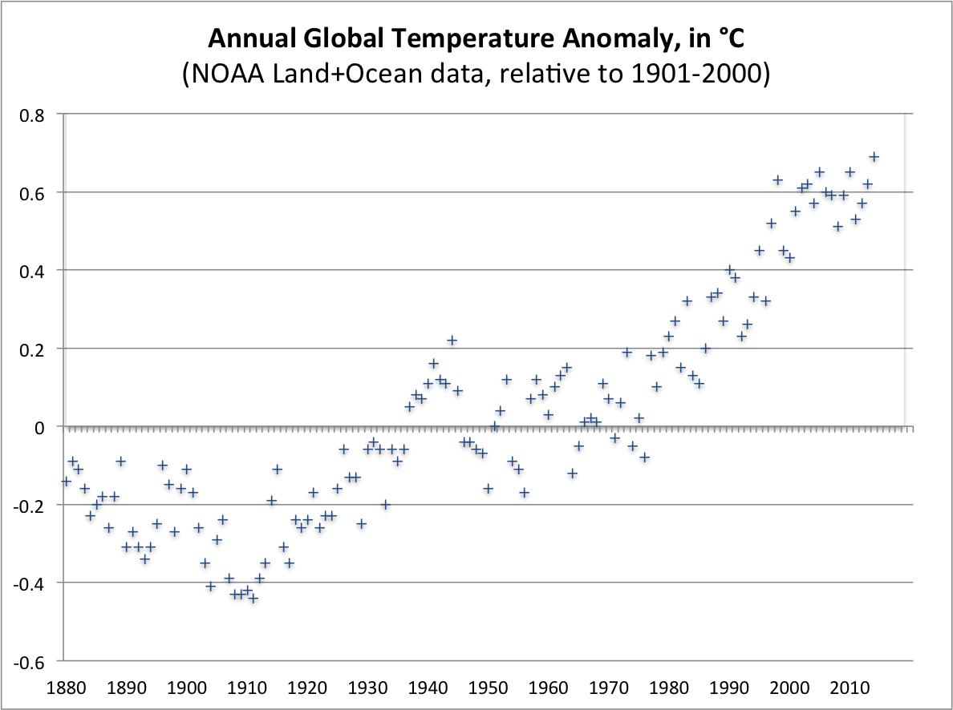
The way to get less pollution
is to make polluting expensive.
Notes:
ftp://ftp.ncdc.noaa.gov/pub/data/anomalies/monthly.land_ocean.90S.90N.df_1901-2000mean.dat
http://www.ncdc.noaa.gov/img/climate/research/2009/decadal-global-temps-1880s-2000s.gif
http://www.ncdc.noaa.gov/sotc/?report=global

Slide 67
Source: BC Budgets 2008-2013

Slide 68
Canada
B.C.
Source: CANSIM 134-0004, 051-0001

Slide 69
Canada
B.C.
Source: CANSIM 384-0038, 051-0001

Slide 70
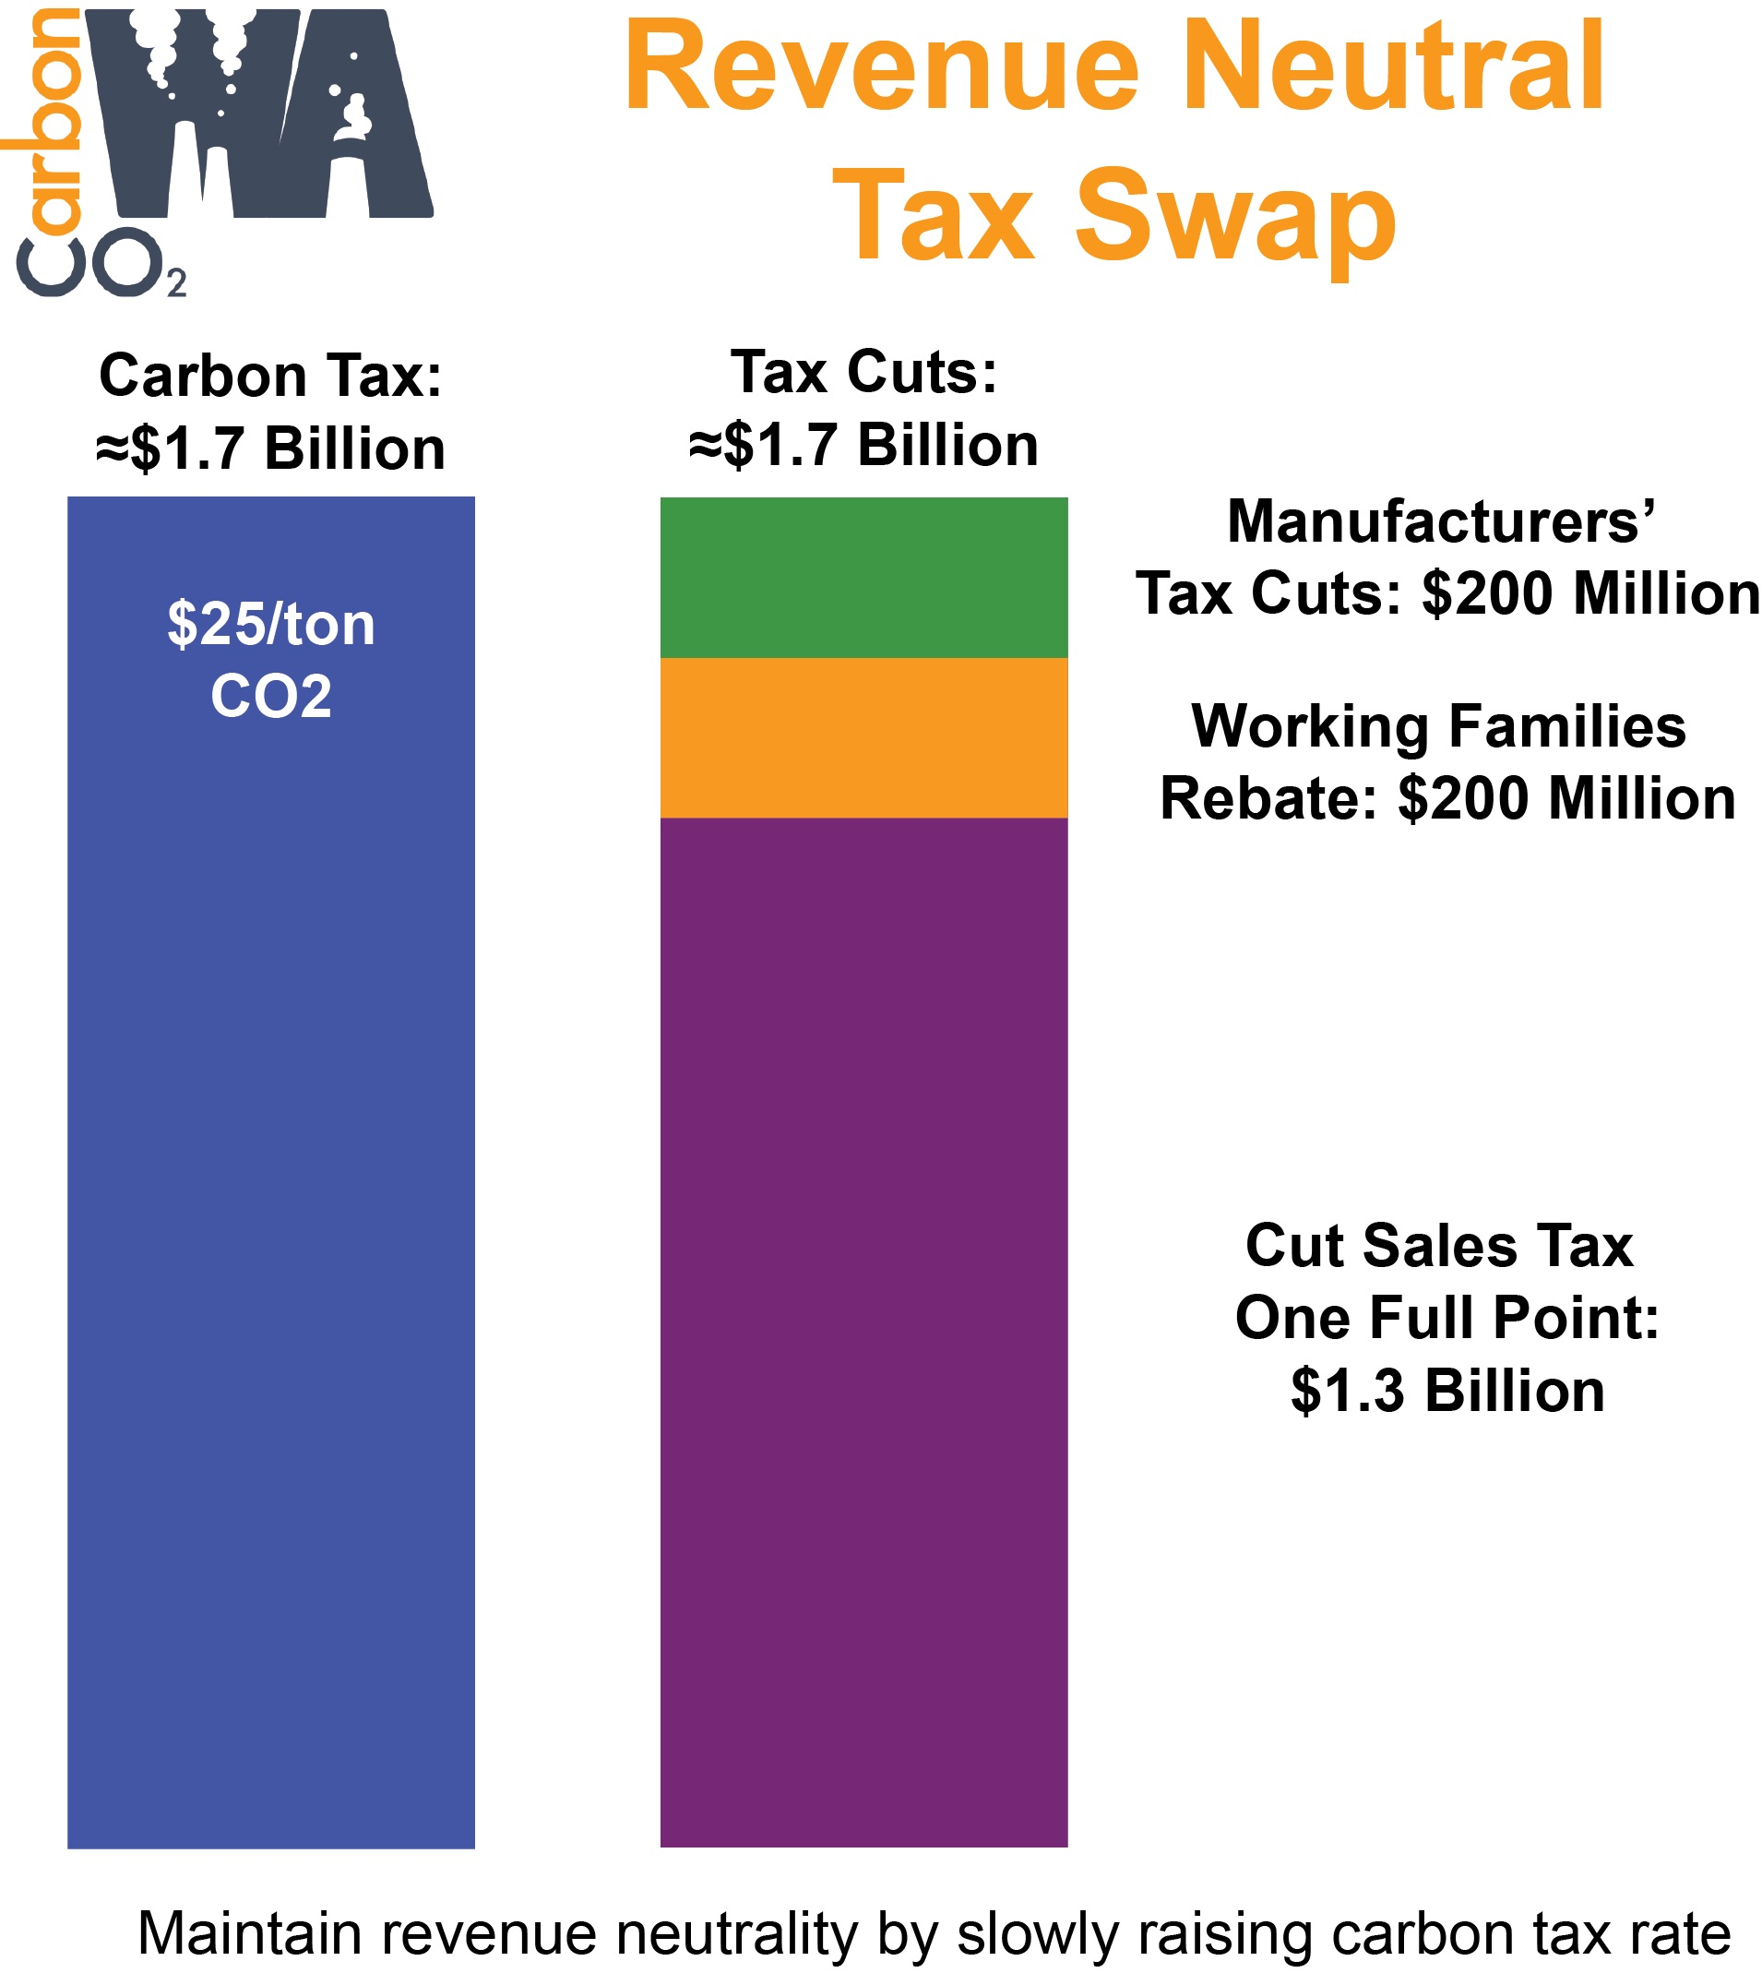

Slide 71
CarbonWA.org draft ballot title
Initiative Measure No. 732 concerns taxes. This measure would impose a carbon emission tax on certain fossil fuels and fossil-fuel-generated electricity, reduce the sales tax by one percentage point and increase a low-income exemption, and reduce certain manufacturing taxes. Should this measure be enacted into law? Yes / No

Slide 72
“Alaska Temporary Fund”
Fossil emissions ≈38m tons CO₂/year (≈ half from industry, half from transport).
A tax of $30 per ton CO₂ ($0.30/gal, $0.03 per kWh coal, etc.) would…
Generate ≈$1b/yr, assuming 10% reduction in emissions (≈$1,400/person)
Why not eliminate the corporate income tax and provide a $700/person dividend?
Source: EPA, AK Dept of Revenue
Notes:
Population 730k (2013)

Slide 73
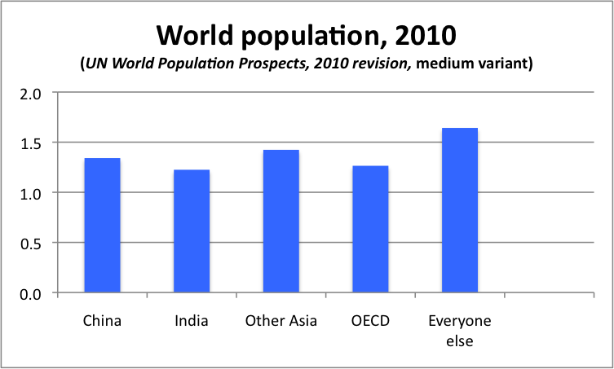

Slide 74
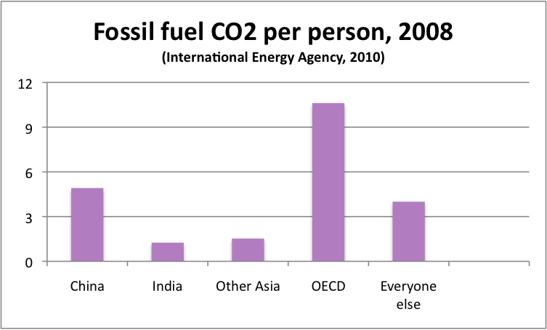

Slide 75
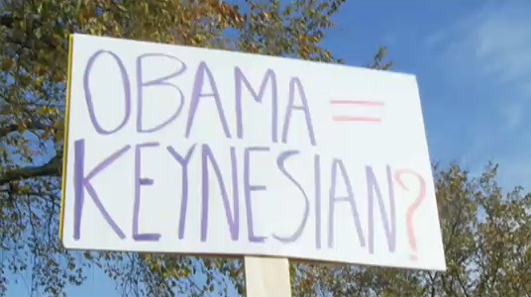

Slide 76
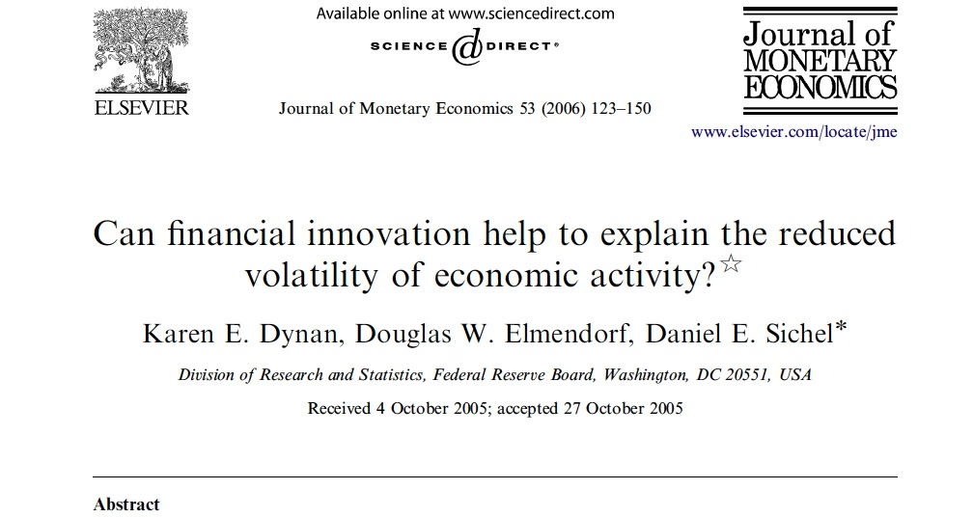

Slide 77
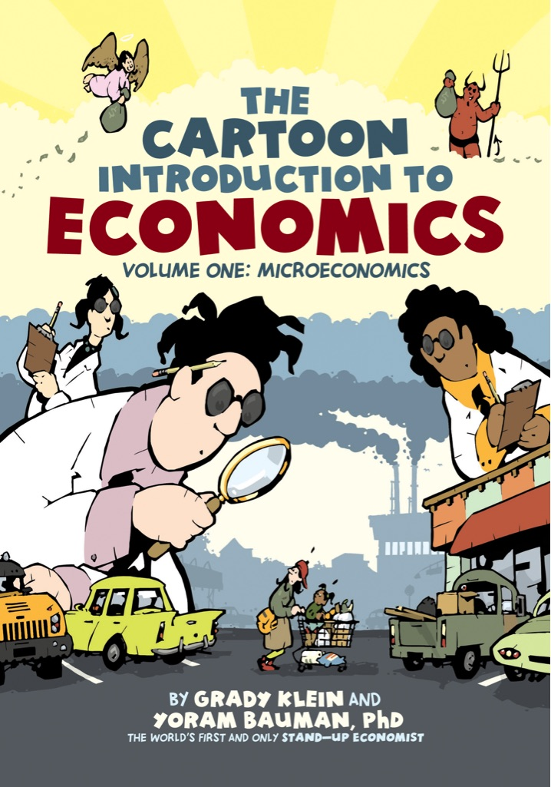
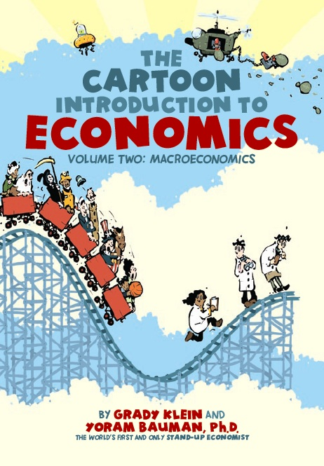

Slide 78


Slide 79
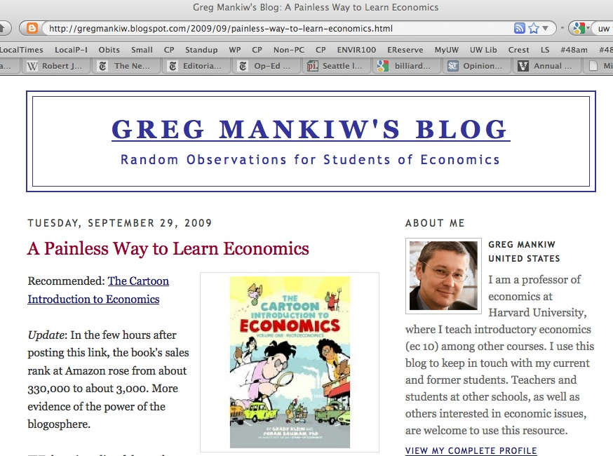

Slide 80
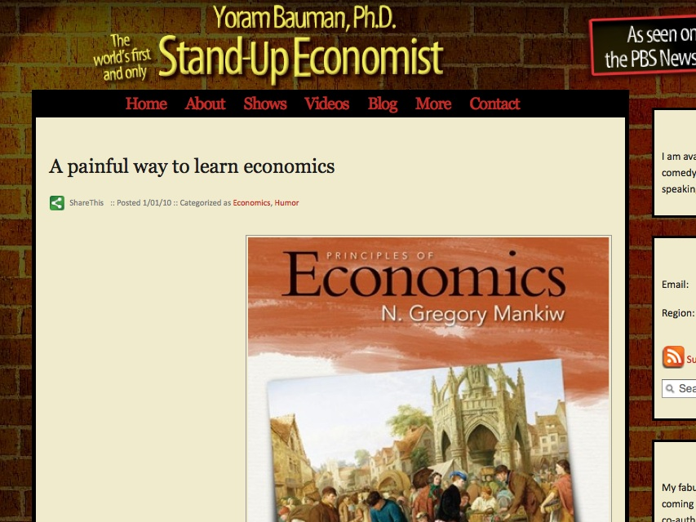

Slide 81
Yoram Bauman
www.standupeconomist.com
yoram@standupeconomist.com

