Slide 1
Lithuania:
The Start-up Nation
Dr. Žygimantas Pavilionis
Ambassador of Lithuania to the United States
Notes:
I would like to welcome you all here at the Embassy of Lithuania.

Slide 2
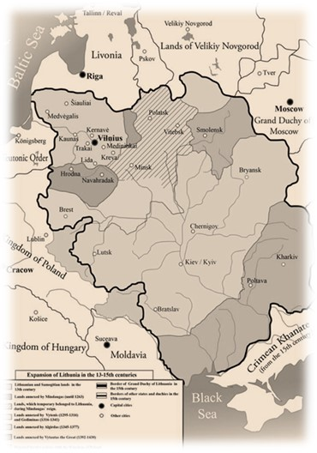
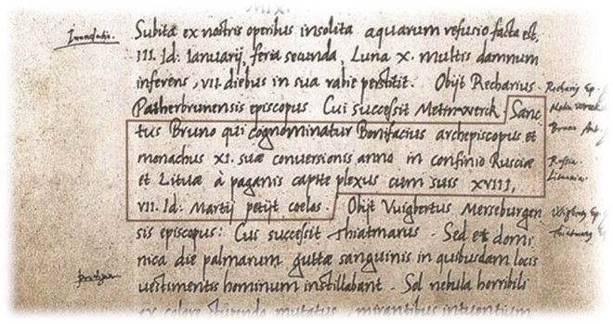
“The US of the Middle Ages”
1009: First record of the name ‘Litua’
Grand Duchy of Lithuania (12th C.-1795): tradition of ecumenism, tolerance, ethnic and cultural diversity
1791: First written Constitution in Europe

Slide 3
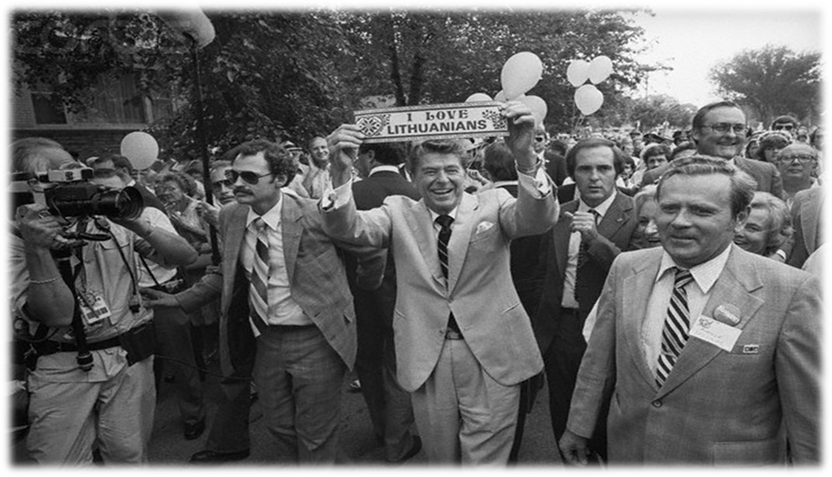
Non-Recognition Policy: Chicago, Marquette Park

Slide 4
Startup nation
During the recent years Lithuanian startup ecosystem has been expanding rapidly and we even have people coming from abroad to establish their startups in Lithuania
Expansion is seen horizontally across all the stages of startup development starting from participation in the events to team formation and launch of the actual products and companies followed by attributable investments

Slide 5
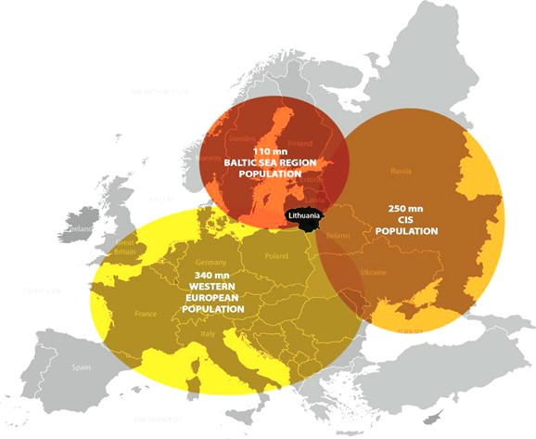
Most Successful Example of Transformation: Facts and Figures
Territory - 65 300 km²
Population – 3.0 million
Capital - Vilnius
Official language – Lithuanian
Currency – EURO
Recent milestones
EU & NATO Membership
Lithuania’s
Millennium Celebration
Presidency of
the Community
of Democracies
OSCE
Chairmanship
EU
Presidency
UN
Security
Council
Eurozone
OECD
2004
2009
2010
2011
2013
2014
2015
2015.05.27
5

Slide 7
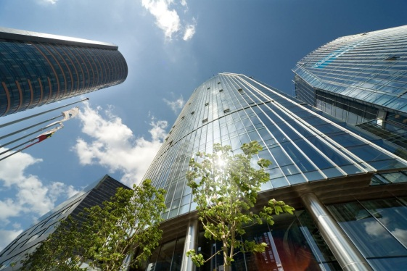
Consistent Growth, Promising Future
Average GDP growth 1995-2007: 9.8% per year, 2014-2015: 3,1% GDP per capita has doubled since the EU accession: 4th in the world for real GDP growth per capita #1 for GDP growth in EU
Share of the private sector: from ~0% GDP to more than 80% in the last 20 years, more than 80% GDP for export. 21rd freest economy in the World (Heritage Found.)
#1 in the EU for use of eGovernment solutions
#11 for ease of starting businesses
#1 globally for conditions for Business Process Outsourcing
0% tax rates for 6 years in special Economic zones and 50% profit tax deduction afterwards, triple tax deduction for R&D
Remarkable Leap¹
 | 1995 | 2011
GDP ($ billion) | 6.3 | 39.6
GDP per capita ($) | 1,716 | 12,230
Cumulative FDI ($ million) | 326 | 13,225
FDI per capita ($) | 88 | 4,110
Credit Rankings
Moody's | A3
Standard & Poor's | A-
Fitch | A-/ stable

Slide 8
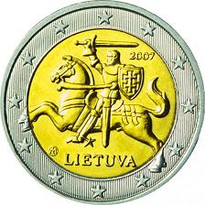
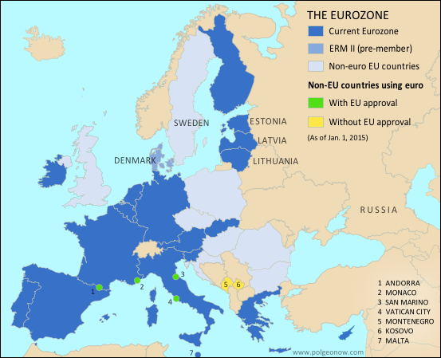
Lithuania – 19th member of € zone:
All three Baltics - at the core of European family

Slide 9
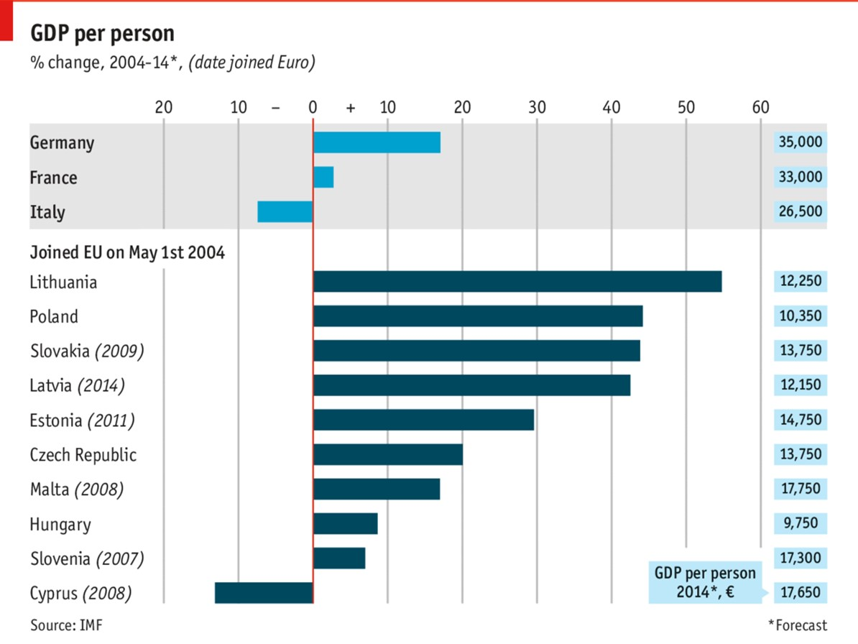

Slide 10
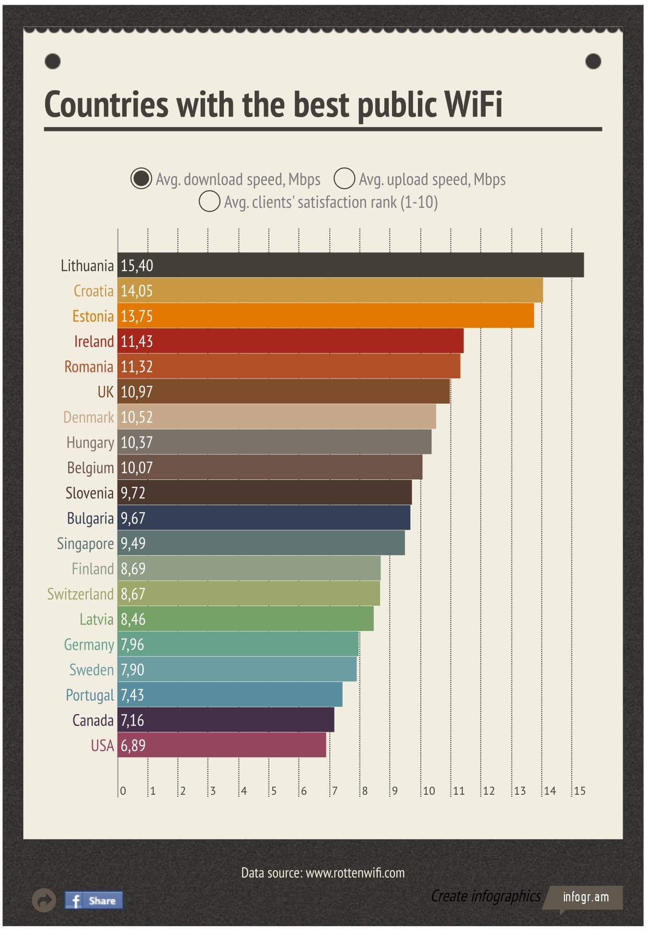

Slide 13
US business presence and new entries
http://www.amlithbc.org/
US investors created the most jobs of all FDIs (2011-2014)/
No1 investor in 2014 (service centers, manufacturing, life sciences) top performers:
Thermo Fisher (biotech) $290M – 430 jobs
Moog Inc. (medical devices) $200M – 100 jobs
Philip Morris (tobacco products) $130M – 430 +40% increase
Kraft (confectionary) $60M – 550 jobs
Kinze Manufacturing (planting equipment $10M - 270 jobs
Intermedix (health care technologies) – $8M - 200jobs
Latest: AIG – 400jobs
twitter: @AmLithBC
13

Slide 14
International success stories – LT star-ups
$ 42 million raised
$ 13,7 million raised
10 million users

Slide 15
Transatlantic Trade and Investment Partnership (T-TIP)
Significant economic gains: EU (€119billion a year), US (€95billion euro a year) or €545 per family in EU and €655 per family in US;
GDP increase: up to 1% for both sides (for Lithuania – 0,58%);
Increasing trade: global trade increase by almost €100 billion;
Overall increase of wages, new employment opportunities;
Innovation growth.
Alaska: TTIP would increase exports to the EU by 9.3%, could boost net employment by 1770 jobs (in 2011 EU purchased 17% of goods exports, 30% of services exports).

Slide 16
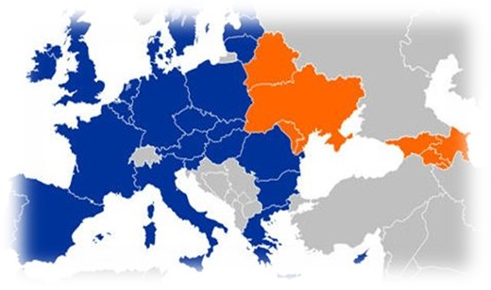
Europe Whole and Free: Enlargement + Europe’s East
Enlargement back on agenda?
Croatia joined on July 1, 2013
Accession talks w/Turkey
restarted (after 3 year break)?
Thessaloniki agenda?
November 28-29, 2013: Vilnius Eastern Partnership Summit:
June 27, 2014: signing of Association Agreements
(Ukraine, Moldova, Georgia)
Visa free with Moldova
May 21-22, 2015: Riga Eastern Partnership Summit
Visa free with Ukraine and Georgia in 2016?
Membership perspective?

Slide 17
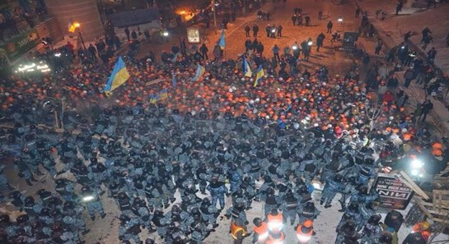
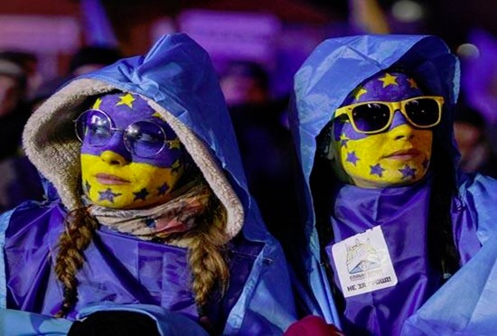
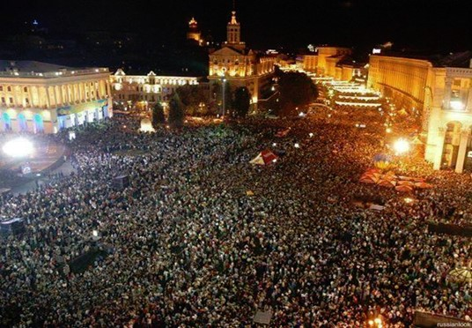
Europe Whole and Free: life after Vilnius: Kyiv versus Moscow?
12/10/2013 @carlbildt: “Eurasia versus Europe in streets of Kiev tonight. Repression versus reform. Power versus people”

Slide 18
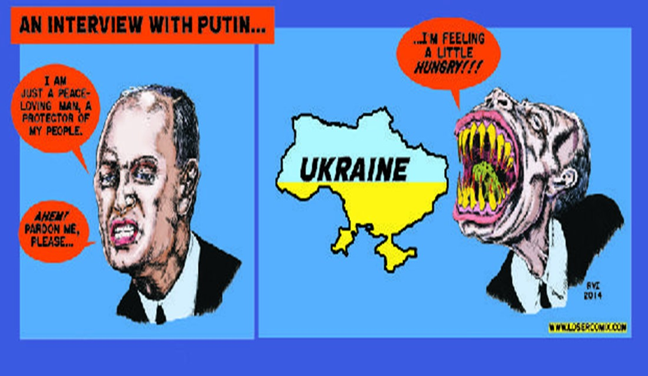
Russia: Putin-led KGB coup?
Back to 1930-1940? North Korea or revisionist Germany before WWII?
Back to dictatorship, empire reconquering “near abroad” till 2016?
Destruction of Association Agreements / killing reform process in neighboring countries?
Ukrainian economic default / reactionary forces back ?
Corrupting and diverting the West.
Killing NATO, TTIP transatlantic links ?

Slide 19
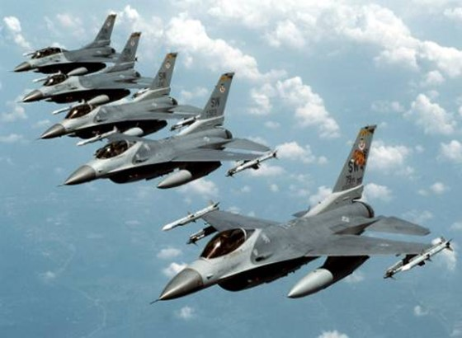
Main Lessons learned: Do we have security agenda?
NATO/US brigade in the Baltics/Poland?
NATO / EU enlargement?
Sectorial sanctions?
Defensive aid to Ukraine?
Russia policy: accommodation containment?
Defending democracy: fighting Putin’s cleptocracy?

Slide 20
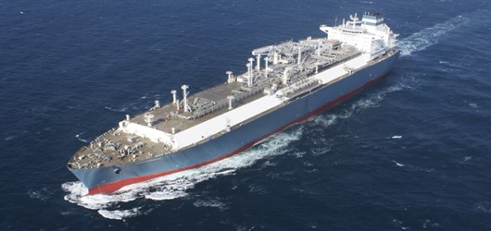
Main lessons learned: Energy Security
Lithuania became the first Central/Eastern Europe nation to have its own LNG import terminal (floating storage and regasification unit).
It has been christened “Independence”.
Independence by numbers:
≤4 Billion cubic meters / y (1.5 bcf)
of regasification capacity, or 75% of combined demand in Lithuania, Latvia, and Estonia.
2- 4 Weeks of emergency gas supply for Lithuania’s priority customers (citizens, hospitals, etc.).
Lithuania has secured a contract with Norway’s Statoil for the minimum volume of LNG needed.
Lithuania still needs US gas - why US has to do it? (LNG exports)
LNG exports to support EU allies who are bearing the burden of economic sanctions by Russia; support the NATO allies; create global gas market; Ensure alternative and reliable supply route and thus help allies to diversify from Russia.
EU has to continue: alternative infrastructure, interconnections, unbundling.

Slide 21
War for hearts and minds Public diplomacy / Cyber

Slide 22
Follow on Social Media
Embassy in Washington DC - http://usa.mfa.lt
On Twitter: @ZygisPavilionis
President @Grybauskaite_LT
Foreign Minister @LinkeviciusL
On Facebook: Zygimantas Pavilionis
(in Lithuanian)

Slide 23
