Slide 1
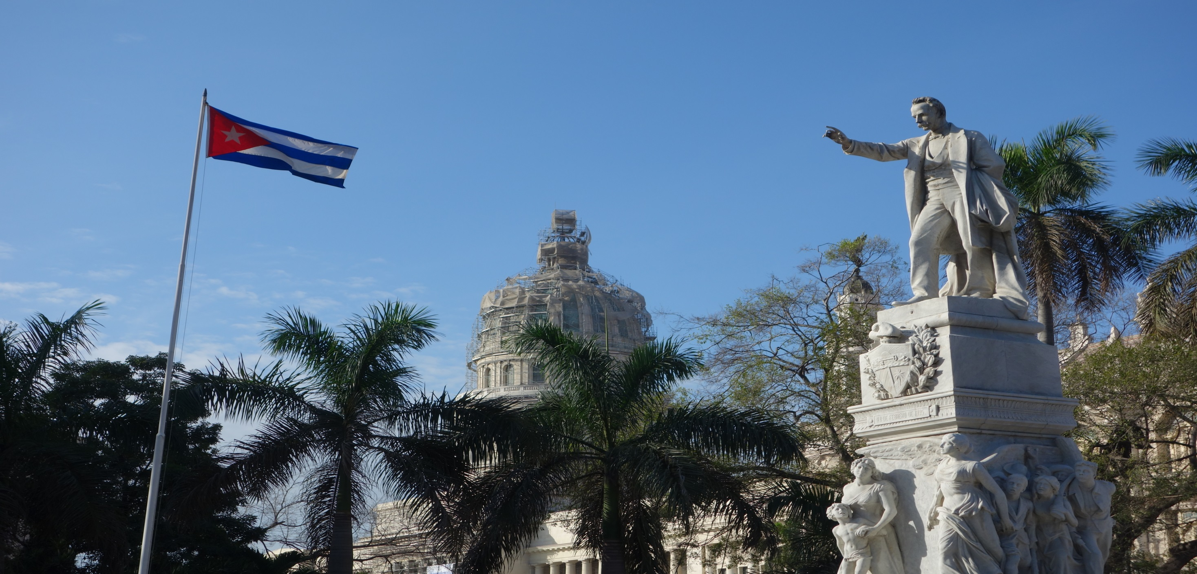
Alaska World Affairs Council
Cuba: The Embargo Within the Embargo
September 30, 2016
Ambassador Charles Shapiro

Slide 2
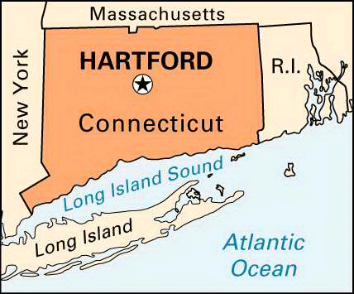
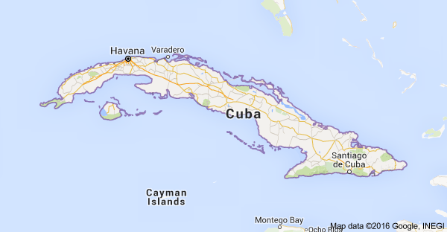
Comparison

Slide 3
Cuba - the next big thing?
 | Cuba | Metro Hartford, CT | Dominican Republic
Population | 11.2 m | 1.2 m | 10.4 m
GDP | $81 bn | $86 bn | $147 bn

Slide 4
Cuban Economy Stuck
1. U.S. Embargo
2. Cuba’s embargo on itself
→It’s 1959 in Havana

Slide 5
Fifth Congress of the PCC

Slide 6
The Future: Cuentapropistas

Slide 7
Automobile Restoration

Slide 8
“Factory” Car Service

Slide 9
App developer

Slide 10
Lectures for Tourists

Slide 11
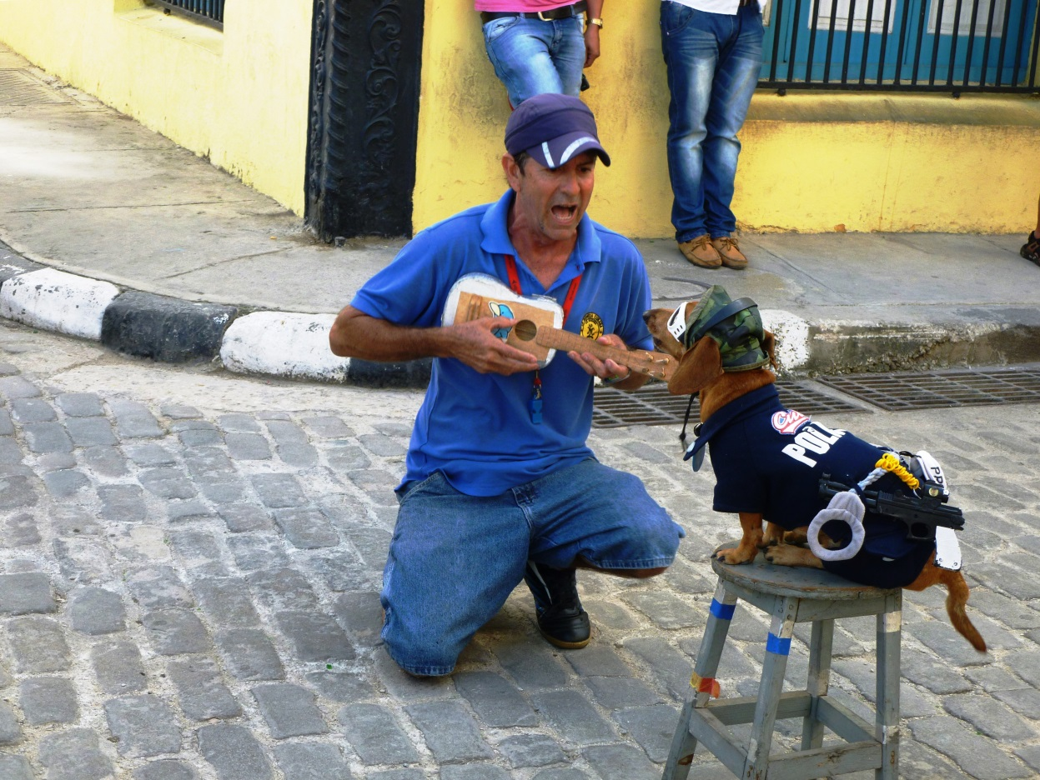
Entertainers

Slide 12
Services

Slide 13
Artists

Slide 14
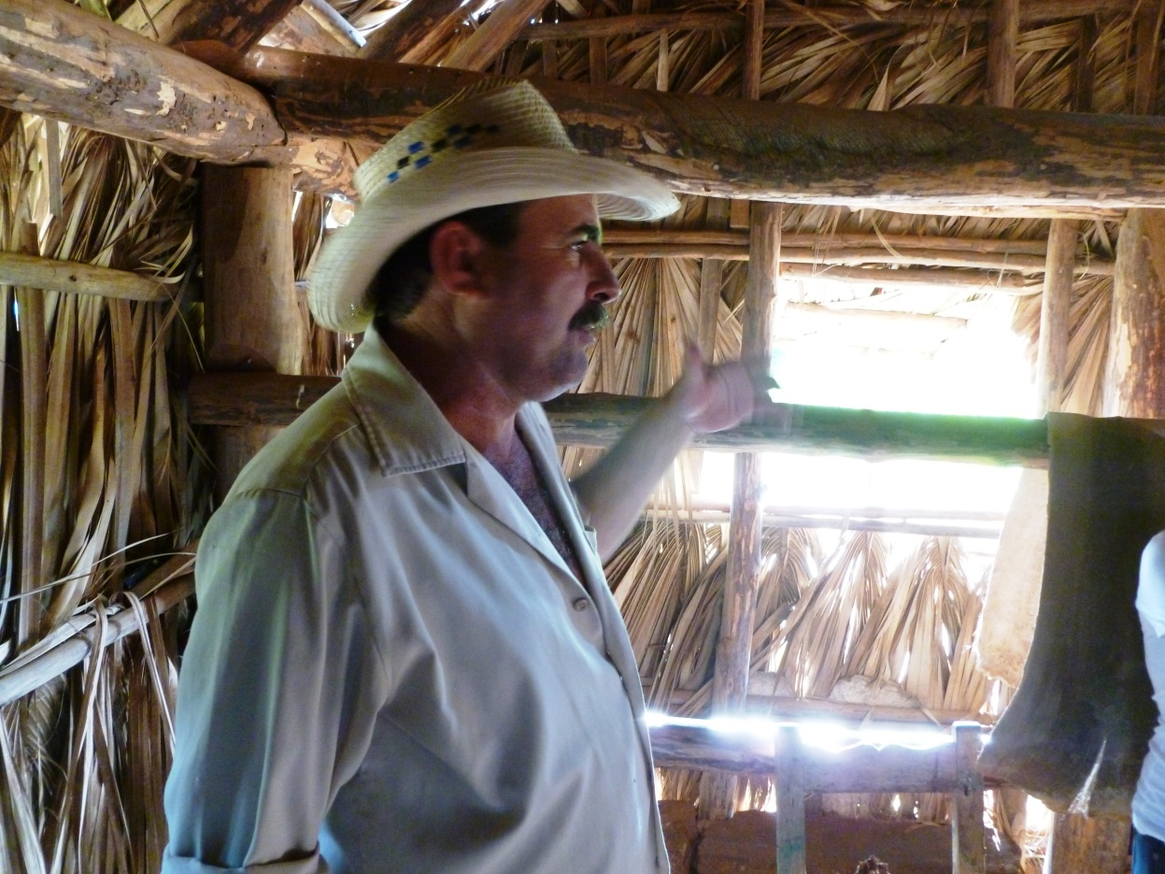
Farmers

Slide 15
 |  | Cuba |  | Dominican Republic | China | Canada | Mexico |  | U.S.
Population |  | 11 m |  | 10.4 m | 1,400 m | 36 m | 120 m |  | 325 m
GDP (US$) |  | $81 bn |  | $0.147 bn | $10.4 T | $1.8 T | $1.3 T |  | $18.0 T
Imports from US |  | $0.3 bn |  | $7.2 bn | $116 bn | $354 bn | $236bn
The U.S. exports $299 million to Canada every 9 hours.
The economic logic of chasing the next big thing...

Slide 16
Travel with us!
February 19-25. Cuba
March 2-9. Colombia
March 19-25. Ireland
April 22-26. Cuba
Contact Clare Morton: CHMorton@gsu.edu

